Slide 1


Virtual Tissue Computer Simulations of Variability of Acetaminophen Toxicity and Exposure in Liver
James A. Glazier
Dept. of Intelligent Systems Engineering
Biocomplexity Institute
Indiana University
Bloomington, IN 47405
Society of Mathematical Biology, Salt Lake City, Utah
Monday, July 17, 2017
IU Bloomington: Ms. Priyom Adhyapok, [Dr. Dragos Amarie], Mr. Josua Aponte-Serrano, [Dr. Julio Belmonte], Dr. Stephen Burns, Dr. Sherry Clendenon, [Alin Comanescu], [Clayton Davis], [Dr. Rita de Almeida], Xiao Fu, [Aaron Dy], [Garth Gast], Dr. Thomas Gast, Dr. J. Scott Gens, [Randy Heiland], [Dr. Susan Hester], [Dr. Mitja Hmeljak], [Dr. Srividhya Jayaraman], Dr. James Klaunig, [Dr. Roeland Merks], [Nazanin Mosavian], [Guilherme Oliveira], [Dr. Nikodem Poplawski], [Ryan Roper], [Dr. Abbas Shirinifard], Dr. James Sluka, Dr. Endre Somogyi, [Dr. Maciej Swat], [Dr. Gilberto Thomas], Dr. Zemin Wang, [Ruei Wu], [Benjamin Zaitlen], [Dr. Ying Zhang]. Indiana University, School of Medicine: Dr. Robert Bacallao, Dr. Nicholas F. Berbari, Dr. Kenn Dunn, Evan V. Greene, Britney-Shea Herbert, Dr. Wei Min Xu. [University of Houston: Dr. Maria Bondesson, Dr. Jan-Ake Gustafsson, Dr. Catharine McCollum]. EPA: [Dr. Nicole Kleinstreuer], Dr. Thomas Knudsen, Dr. Imran Shah, Dr. John F. Wambaugh. [University of Michigan: Dr. Santiago Schnell]. [KUMC: Dr. Charles Little]. University College London: Ana S. Dias, Irene de Almeida, Dr. Claudio Stern, University of Dundee: Dr. Mark Chaplain. Moffitt Cancer Center: Dr. Heiko Enderling. CRG Barcelona: Dr. James Sharpe. [Cambridge University: Dr. Octavian Voicelescu]. University of Paris 6: Dr. Francois Graner. [University of Wisconsin Milwaukee: Dr. Roshan D’Souza]. [UCSF: Dr. Tony Hunt], Emory University: Dr. Fereydoon Family, Dr. Hans Grossniklaus. Georgia State University: Dr. Yi Jiang. University of New Mexico, School of Medicine: Heather H. Ward, Angela Wandinger-Ness. Amgen: Michael Boedigheimer, Michael Damore, William G. Richards. Otsuka Pharmaceuticals: Sandro Rossetti. Mayo Clinic (Rochester, MN): Peter C. Harris
Support: NIH NIGMS-R01GM076692, NIGMS-R01GM077138, NIH U01-GM111243, Falk Medical Research Trust, IUCRG, NSF

Slide 2

Drug-Induced Liver Injury (DILI)
Liver is the first organ exposed to molecules absorbed by the gut (Xenobiotics) and the main site for molecular breakdown and detoxification
Often the first (main) organ damaged by xenobiotic exposure
Many types of damage depending on acute or chronic exposure—necrosis, steastosis, cirrhosis, cancer,…
Main reason for failure of drug candidates which have shown clinical efficacy
Common, serious and often unpredictable side effect for many environmental chemicals and drugs
Can limit acceptable doses of antibiotics, chemotherapeutics,…
Susceptibility is highly variable within populations
Susceptibility can be variable in a single individual (e.g. depends on alcohol consumption, grapefruit and broccoli consumption, multi-drug interactions, bacterial and viral infections, age, obesity, sleeplessness, time since last meal, …)
Predicting liver toxicity and effective remediation could accelerate drug development, personalize drug use, and allow more effective use of existing drugs
Sluka

Slide 3
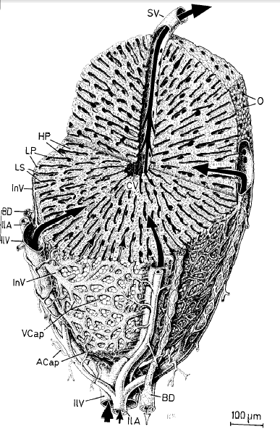
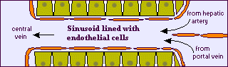
Liver Structure and Function
Primary metabolizing organ of the body and first line of defense against toxins
Live composed of millions of lobules
Blood enters at Portal Triads and leaves at Central Vein
Lobules composed or repeating triangular modules in which sinusoids take blood from Portal Triad to Central Vein
Sinusoids are capillary-like structures composed of endothelial cells surrounded by hepatocytes
Liver Lobule¹
Liver Sinusoid²
Human Microscopic Anatomy: An Atlas for Students of Medicine and Biology, R. V. Krstic, Springer-Verlag, 1991 (ISBN 978-3-540-53666-6).
http://biology.about.com/library/organs/bldigestliver.htm
Sluka

Slide 4
Liver Zonation and Function
Core of lobule around Central Vein (peri-central) has different metabolic function from periphery near Portal Triads (peri-portal)
Pericentral region largely uses Phase I detoxification (modification by Cytochrome P450s)
Periportal region largely uses Phase II detoxification (conjugation by transferases)
Liver Lobule¹
Liver Sinusoid²
Human Microscopic Anatomy: An Atlas for Students of Medicine and Biology, R. V. Krstic, Springer-Verlag, 1991 (ISBN 978-3-540-53666-6).
http://biology.about.com/library/organs/bldigestliver.htm
Sluka

Slide 5
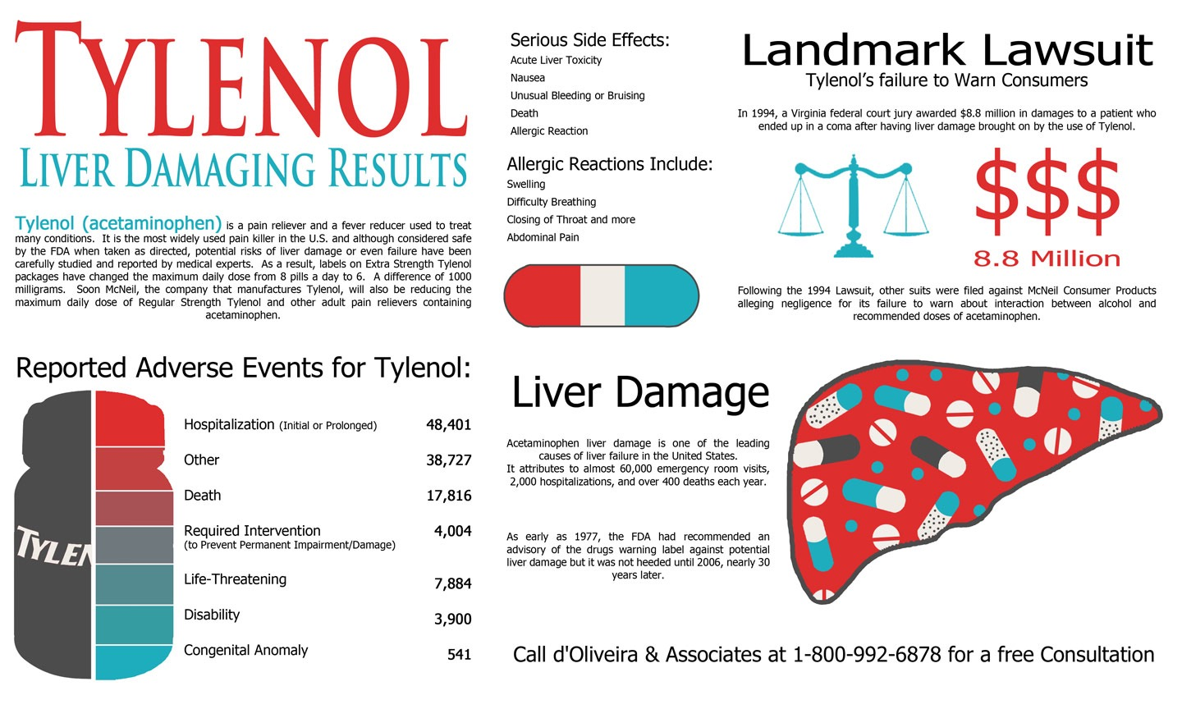

Acetaminophen (APAP) Liver Damage
Widely used over the counter analgesic and fever reducer. US, 27 billion doses/year (population 317M), UK, 20 billion doses/year (population 64M)
Therapeutic index ~ 2-10 (toxic dose/therapeutic dose), very small for over-the-counter medication
Overdose results in rapid centrilobular necrosis of the liver, often leads to death
Mouse Liver 250 mg/kg APAP after 6 h
Portal Triad
Central Vein
Necrotic Region
Image courtesy of J. Klaunig and Z Wang
Cover story of New Scientist,
Volume 222, 31 May 2014, Pages 34–37
Safe Dose is unpredictable:
A dose of APAP safe for one person can kill another
A dose of APAP safe for a person at one time can kill them another time
Leading cause of acute liver failure and accounts for most drug overdoses in the Western world (>>1000/year in USA)
Sluka

Slide 6
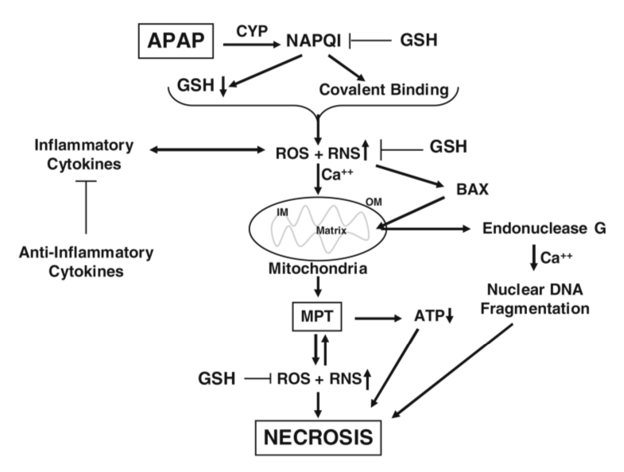
APAP Toxicity Mechanisms and Issues
APAP isn’t particularly toxic
Product of APAP’s Phase I detoxification in liver is toxic NAPQI
NAPQI binds irreversibly to Glutathione (GSH), main buffer against reactive oxygen species (ROS)
If a cell’s Glutathione level gets too low, the cell dies by necrosis
Hinson et al., Handb Exp Pharmacol (2010)
Liver has huge regenerative capacity after surgical resection but liver fails to regenerate after severe Acetaminophen poisoning, which kills only a small fraction of hepatocytes
No good therapies: ROS buffer supplements reduce liver damage for only 30-90 minutes after ingestion of APAP
Only other treatment is a very rapid liver transplant
Sluka

Slide 7
Aims for Modeling
Predict APAP and NAPQI exposure (microdosimetry) within the liver
Predict blood-serum levels of NAPQI and other metabolites (which can be measured clinically)
Explain detailed mechanisms of APAP toxicity
Understand why focal damage leads to organ necrosis
Understand the key factors which control the risk of a therapeutic dosage of APAP turning lethal
Understand origin of population and intra-individual variability in sensitivity
Well calibrated model for other types of liver toxicity (Drug-Induced Liver Damage) to predict liver toxicity of other molecules, especially drug candidates
Sluka

Slide 8
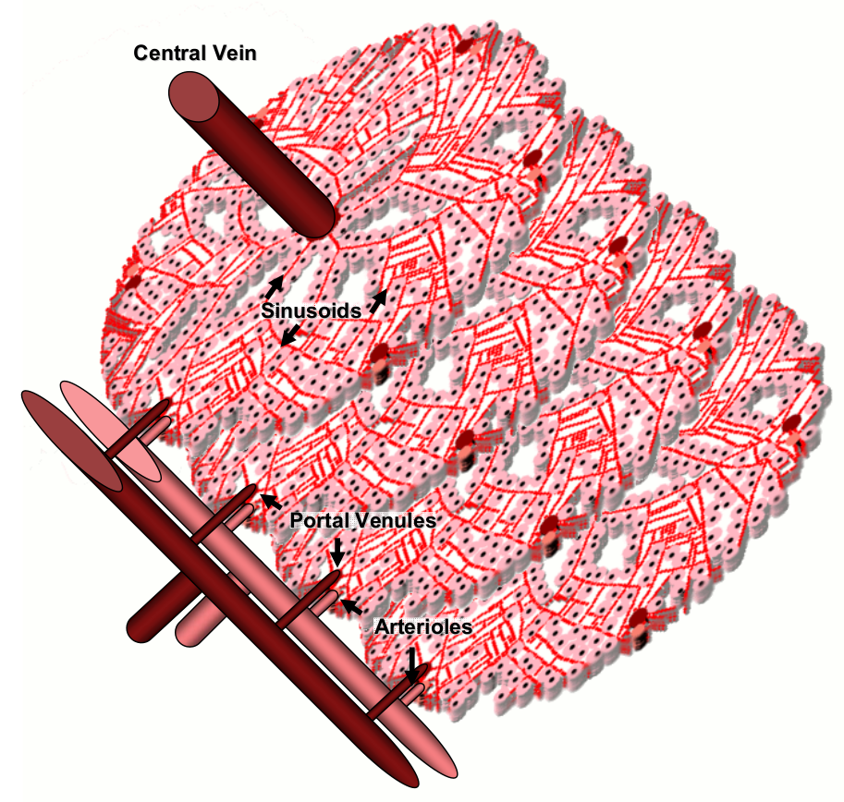
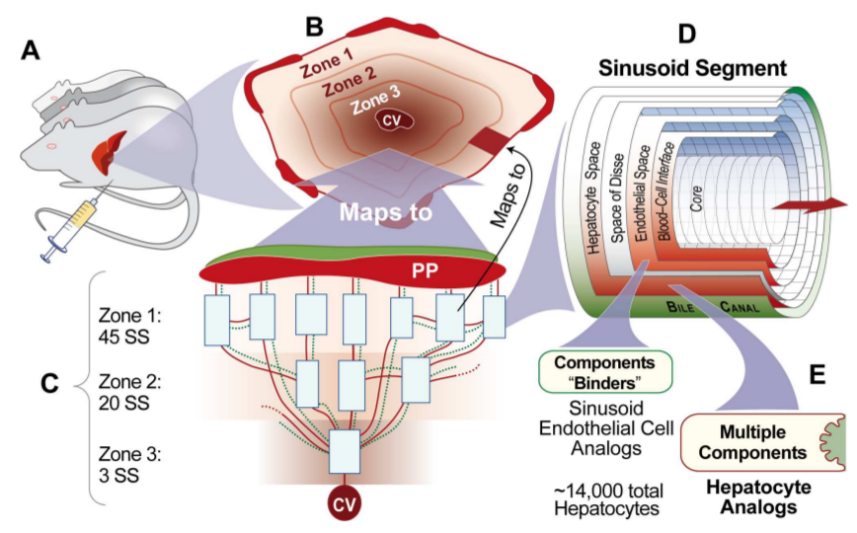
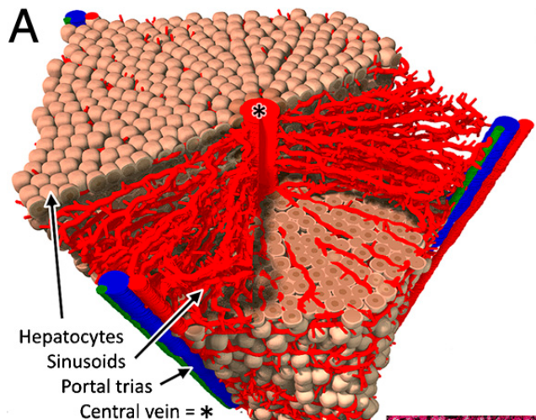
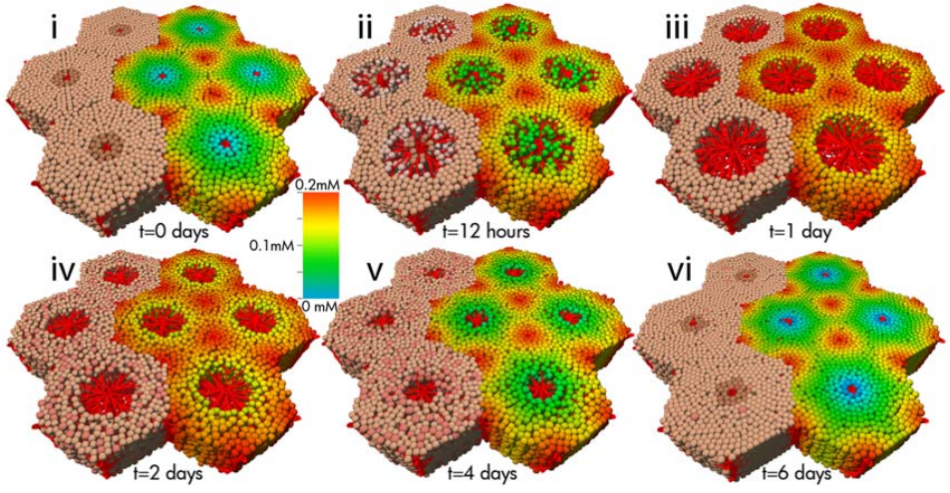
Virtual Liver Models
Wambaugh et al., PLoS Computational Biology (2010)
Smith et al., PLoS Computational Biology (2016)
Hoehme et al., Proceedings of the National Academy of Sciences (2010)
Schliess et al., Hepatology (2014)

Slide 9
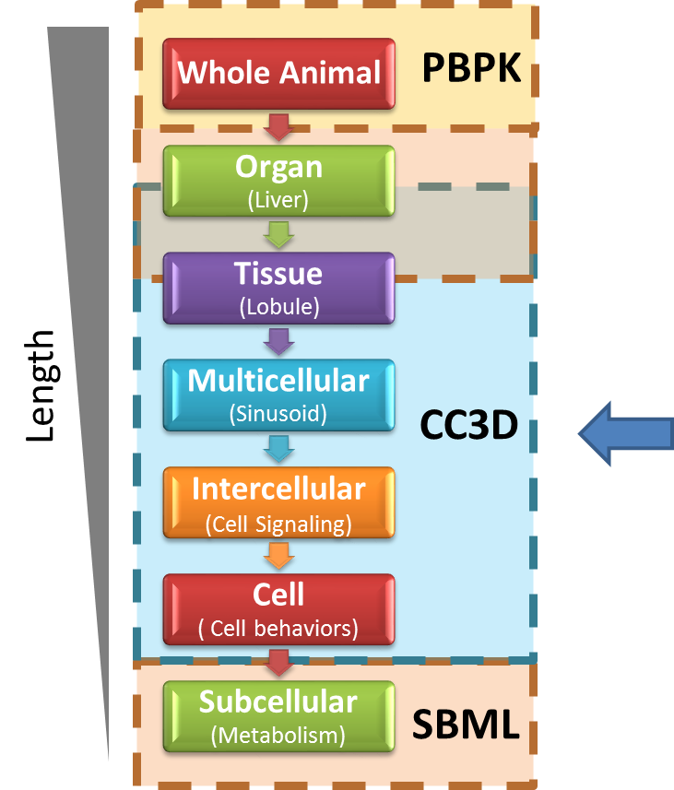
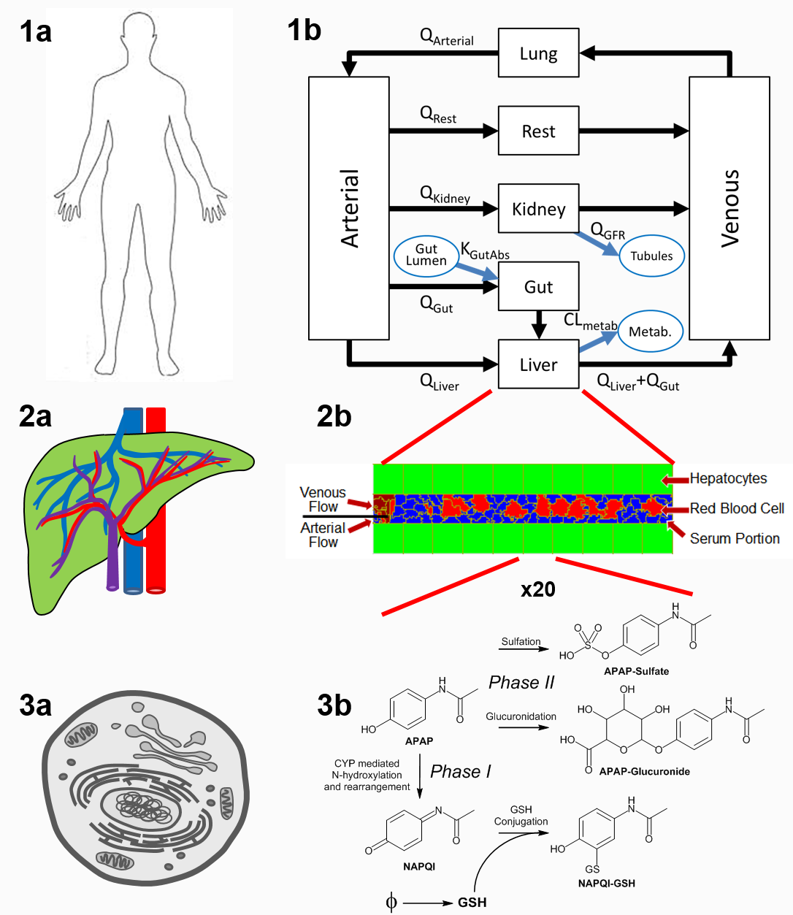
A Multi-scale Liver-centric Model of APAP Pharmacology
Structure
Module
PBPK
(SBML)
Whole-body
Multicell
Flow/Transport
(CC3D)
Organ/Tissue
Reaction
Kinetics (RK)
(SBML)
Cell/Subcell

Slide 10
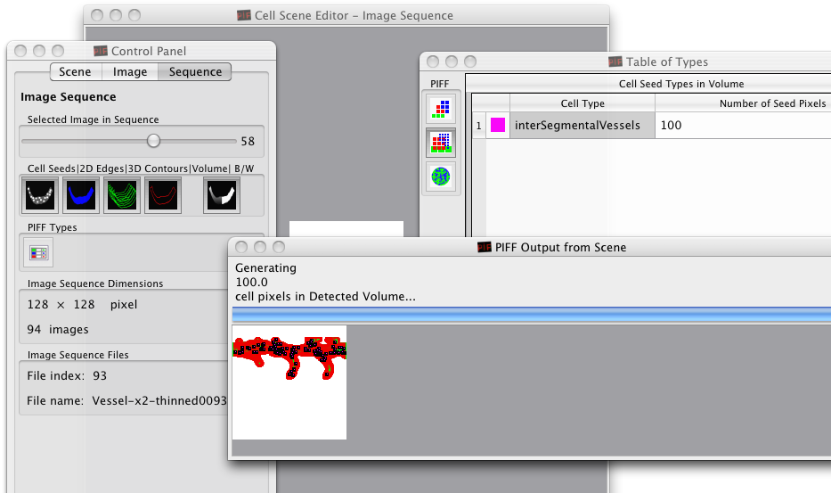
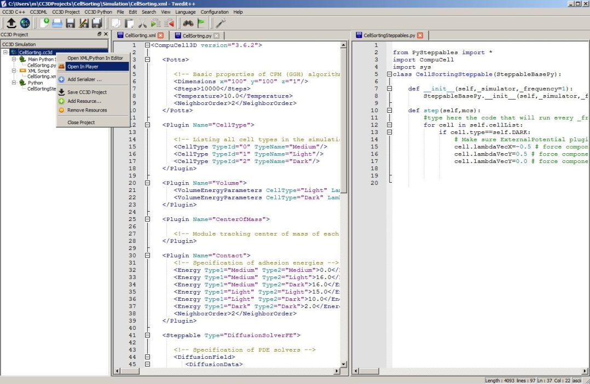
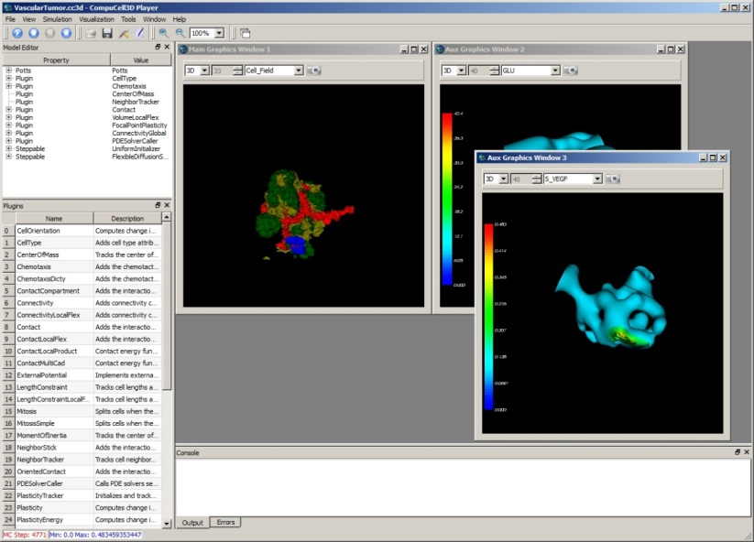
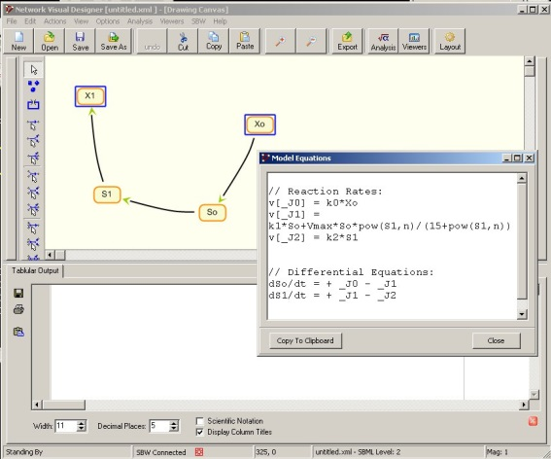
CompuCell3D
Cross-platform, open-source environment for building and running Virtual-Tissue simulations
Written in C++ and Python
Describes models using combination of XML (CC3DML) and/or Python
Parallel implementation on GPU’s and multi-core machines
Simulation-wizards, simulation editors, graphical interfaces, visualization tools, SBML Dynamic Network Solvers, and FE solvers (experimental support)
SBML models can run inside each cell
Model Generation, e.g. using H. Sauro’s JDesigner

Slide 11
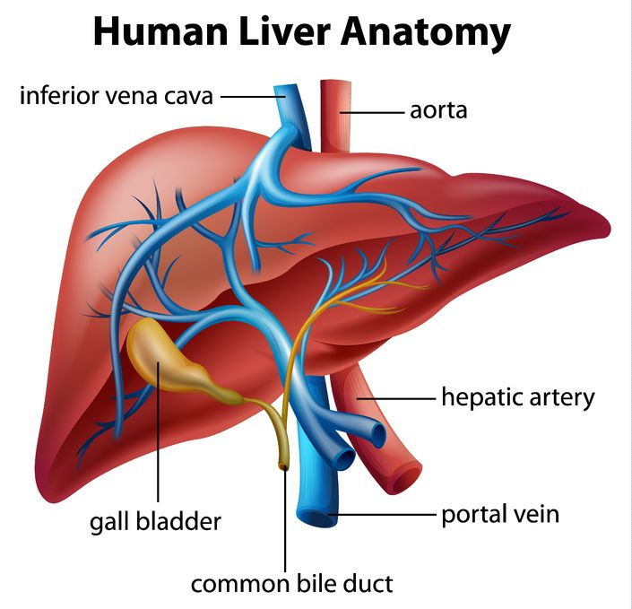
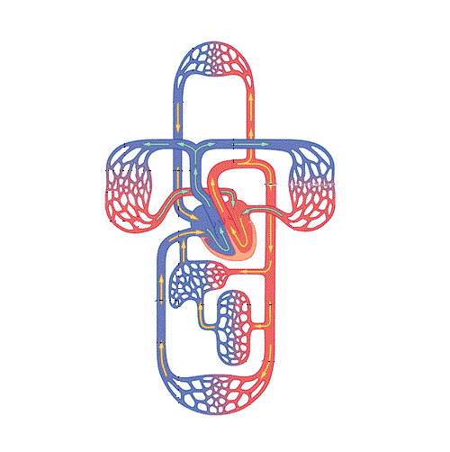
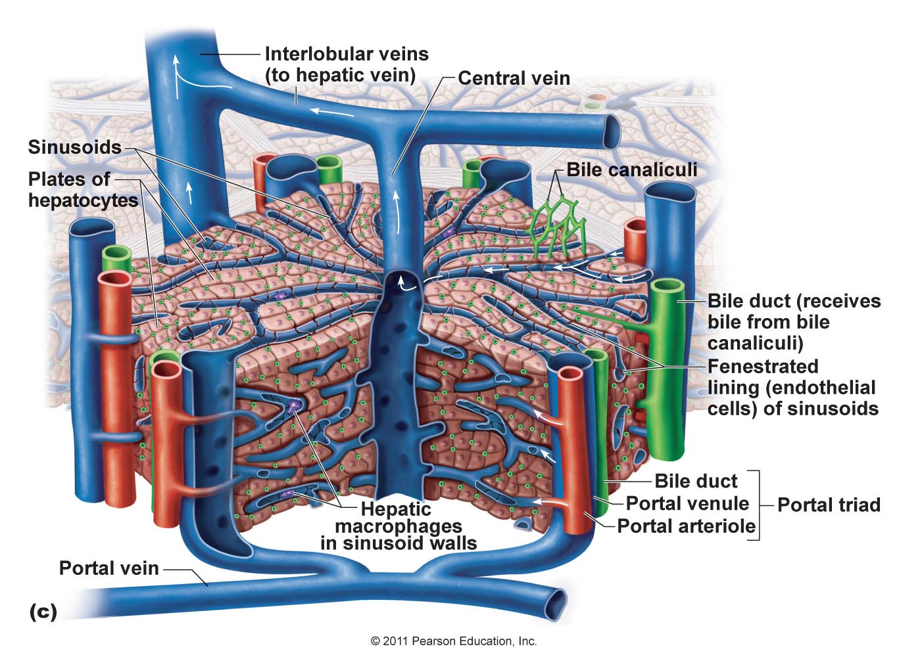
Circulation of Blood Distributes Xenobiotics to Liver and Organs
Source:
http://anatomy-medicine.com/digestive-system/26-the-liver.html
Source:
http://www.aviva.co.uk/health-insurance/home-of-health/medical-centre/medical-encyclopedia/entry/function-the-blood-circulation/
Source: https://cms.webstudy.com

Slide 12
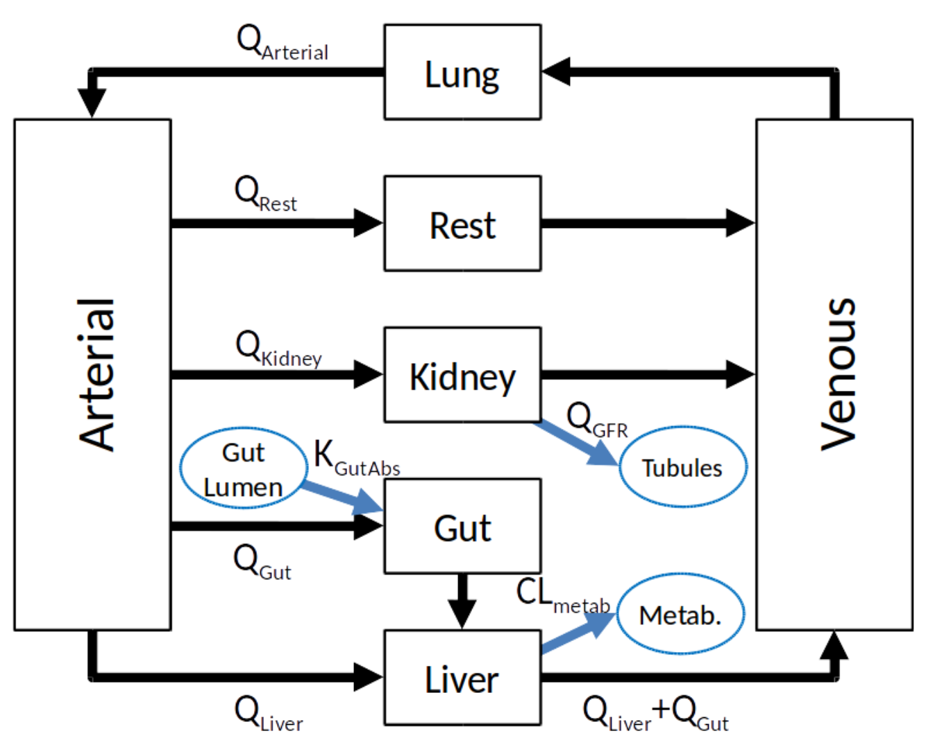
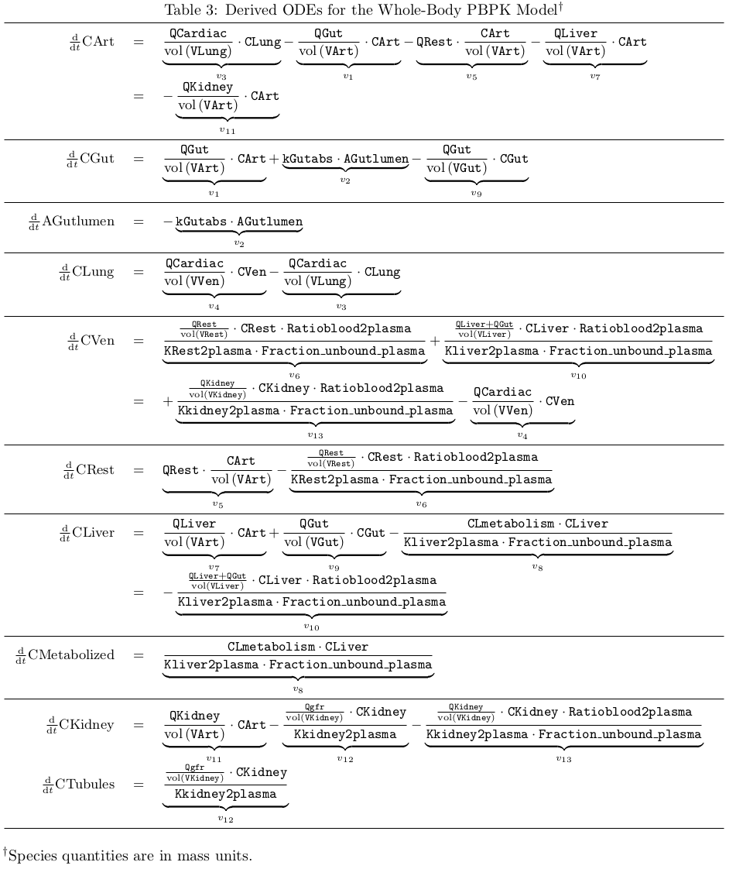
PBPK Submodel of Xenobiotic Transport by Blood
Parameters for sensitivity studies
Body weight: allometric relations ^{[1]}
Absorption rate from gut lumen
Glomerular filtration rate
Unbound fraction in blood plasma
Blood:Plasma ratio
Tissue:Plasma partition coefficient
$$V∝bw;Q∝{bw}^{3/4}$$
West et al., Science (1997)
Wambaugh, J. & Shah, I. Simulating Microdosimetry in a Virtual Hepatic Lobule. PLoS Computational Biology 6, (2010).
http://sys-bio.org/

Slide 13
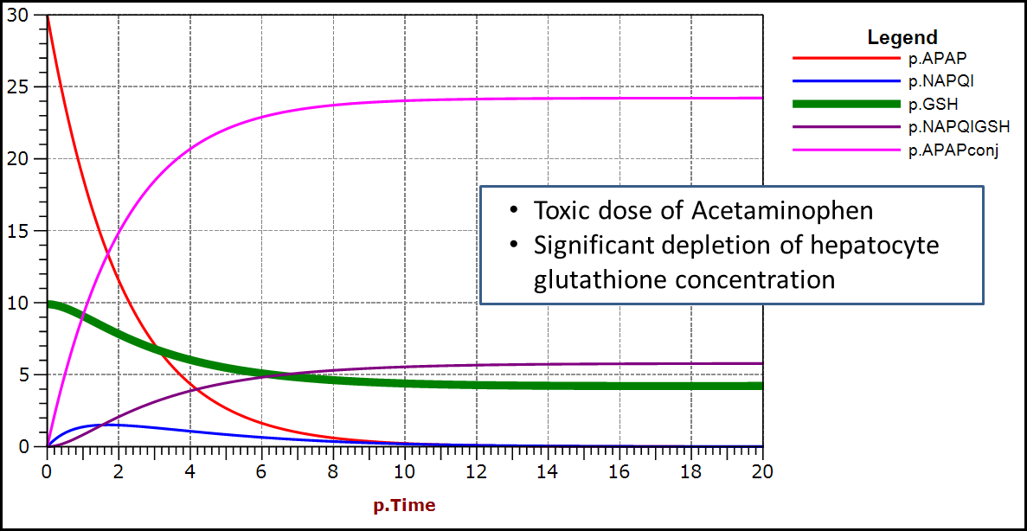
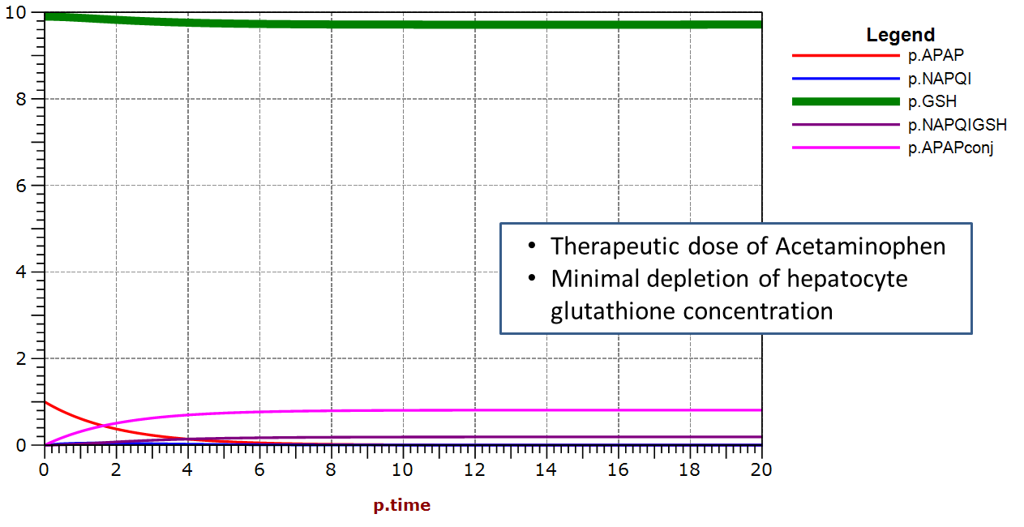
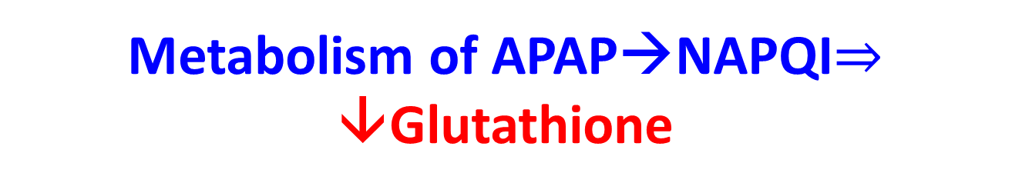
Metabolism of APAP→NAPQI$⇒$ ↓Glutathione
Acetaminophen (APAP) metabolized in the liver in both Phase I and Phase II reactions.
High APAP doses deplete hepatocyte Glutathione (GSH) levels, leading to hepatocyte death
Glutathione:
Acts as a RedOx buffer of the cell’s cytosol
Antioxidant, reactive oxygen species (ROI) and electrophile scavenger
Cofactor for several enzymes
Sluka
Notes:
The greyed out reactions are not included in the hybrid model.
The Glutathione (GS) – Oxidized Glutathione (GSSG) couple is ubiquitous in animal cells. This couple controls:
The RedOx potential of the cell’s cytosol. (The cytosol is at a lower oxidation potential than is the blood.)
GSH is a major cellular antioxidant, reactive oxygen species scavenger and electrophile scavenger.
GSH is a cofactor for several enzymes
[GSH] in the hepatocytes is higher than most cells, perhaps because of the high level of oxidation that occurs in the liver.
Oxidized GSH (GSSG) is converted back to GSH by Glutathione Reductase (an energy dependent enzyme).
GSH is synthesized by the cell at a fairly low rate. That rate is overwhelmed in APAP overdose.
Clinically, N-acetylcysteine (a precursor to GSH) is used to attempt to overcome APAP toxicity. N-acetylcysteine must be administered within a couple hours of overdose to have an effect.

Slide 14
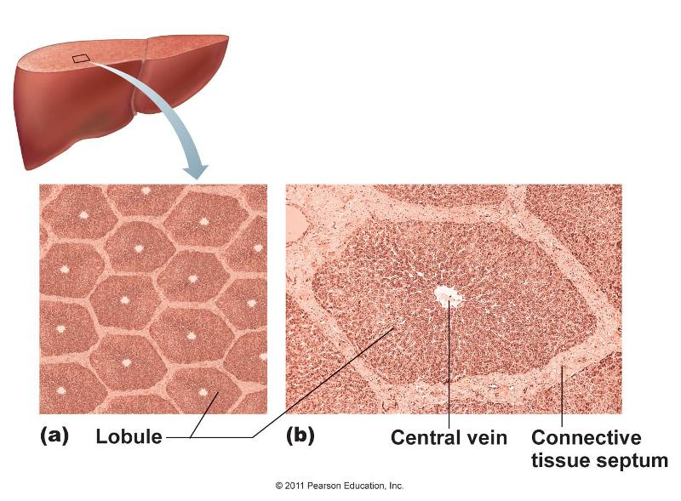
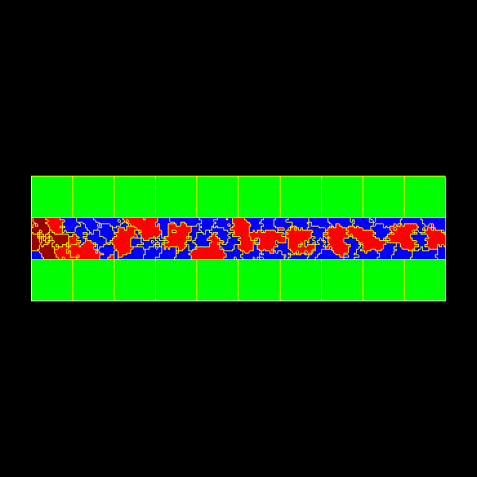
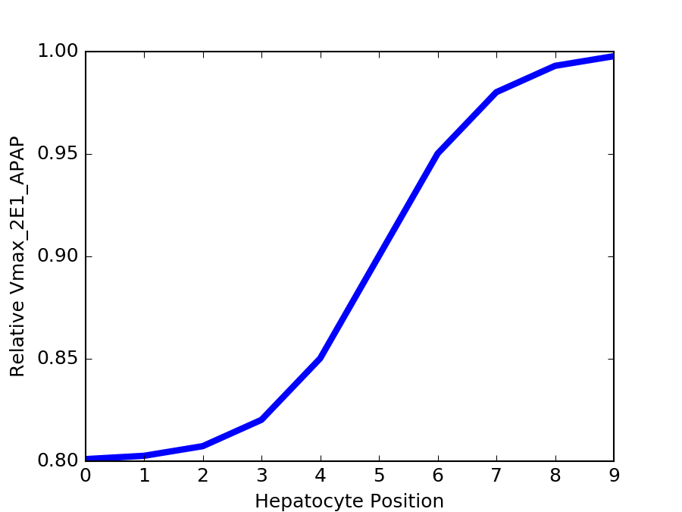
Model of Transport in a Sinusoid in a Liver Lobule (CC3D)
Hepatocytes
Red blood cells
Serum portions
flow
Peri-central
Peri-portal
Zonation of CYP activity
in hepatocytes
Model simplification
No anastomosis
No variation in sinusoid diameter
No variation in flow
Relative Vmax
Source: https://cms.webstudy.com
CompuCell3D:
Swat, et al., Methods in Cell Biology (2012)
Peri-portal
Peri-central

Slide 15
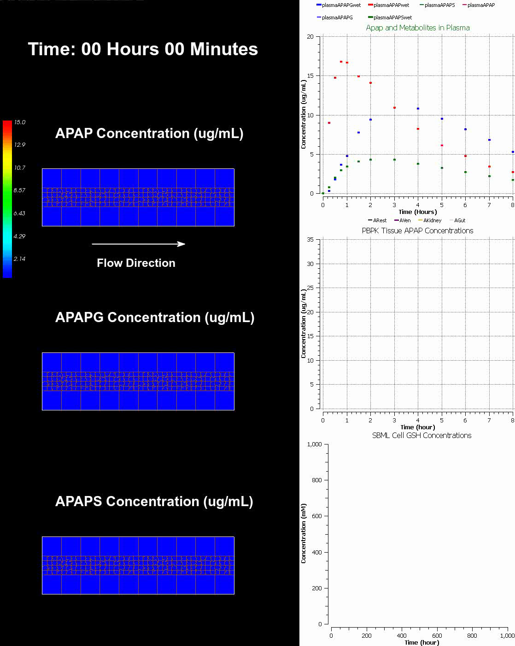
Full simulation of xenobiotic uptake, distribution, metabolism and clearance (CDME)
Fitting parameters to match fit between predicted and average human adult make serum time series defines the reference simulation REFSIM
70 kg human
20 mg/kg oral dose

Slide 16
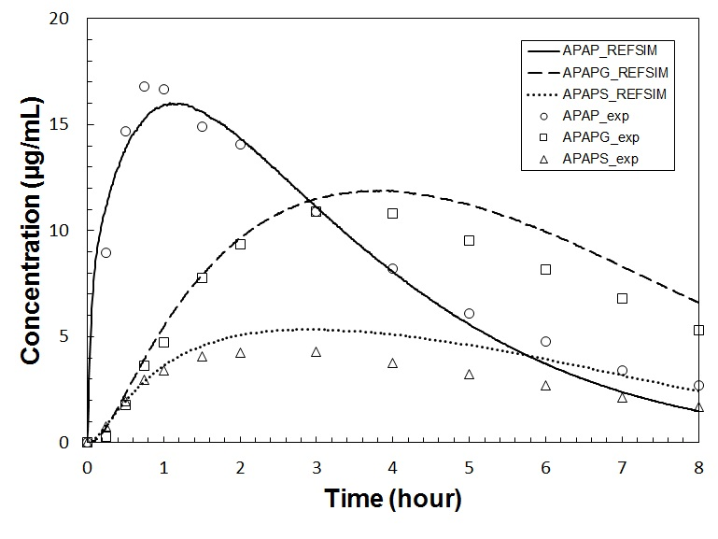
Quantifying the Body’s Response
Serum-level
Cell-level
Cmax
AUC
Area under the curve
RMSE
Root mean squared error
Tmax
Max cellular production of APAP-GSH in any hepatocyte
→ equals max integrated cell depletion of GSH → liver’s max local response

Slide 17
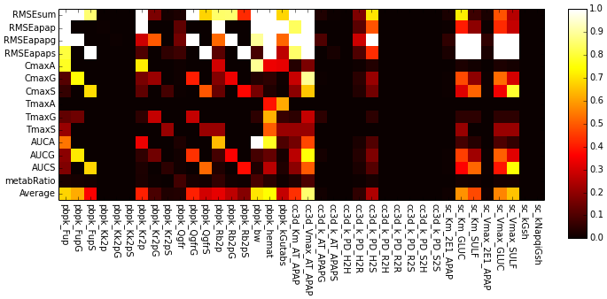
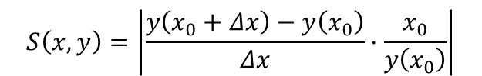
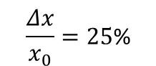
Parameter Sensitivity with respect to reference parameter set
Serum-level
descriptor
Sensitivity of a model output to
single-parameter variation with respect to value in REFSIM parameter set
$$S\left(x,y\right)=\left|\frac{y\left(x_{0}+Δx\right)−y\left(x_{0}\right)}{Δx}⋅\frac{x_{0}}{y\left(x_{0}\right)}\right|$$
Bright domain: model output is sensitive to change of parameter
Dark domain: parameter has little impact on model output
$$\frac{Δx}{x_{0}}=25\text{\%}$$

Slide 18
Parameter Sensitivity Pattern 3 – compound-specific parameter influence
Serum-level
descriptor
Total amount of metabolite produced for given dosage (Area under the curve of serum-level time series of chemical concentrations)
pbpk_Fup
pbpk_Rb2p
Unbound fraction in the blood serum of a chemical
Blood:serum partition coefficient of a chemical

Slide 19
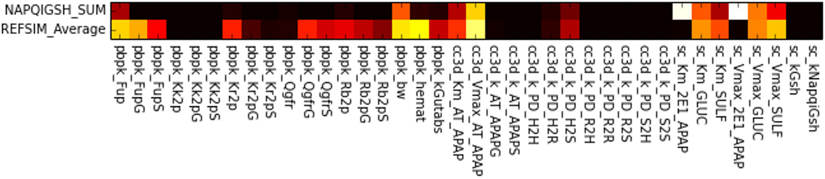
Parameter Sensitivity with respect to REFSIM parameter set
Serum-level
descriptor
Cell-level
descriptor
APAP-GSH
sc_Km_2E1_APAP
sc_Vmax_2E1_APAP
Maximal cumulative amount of APAP-GSH in any hepatocyte
Michaelis-menten constants of CYP-mediated Phase I metabolism of APAP

Slide 20
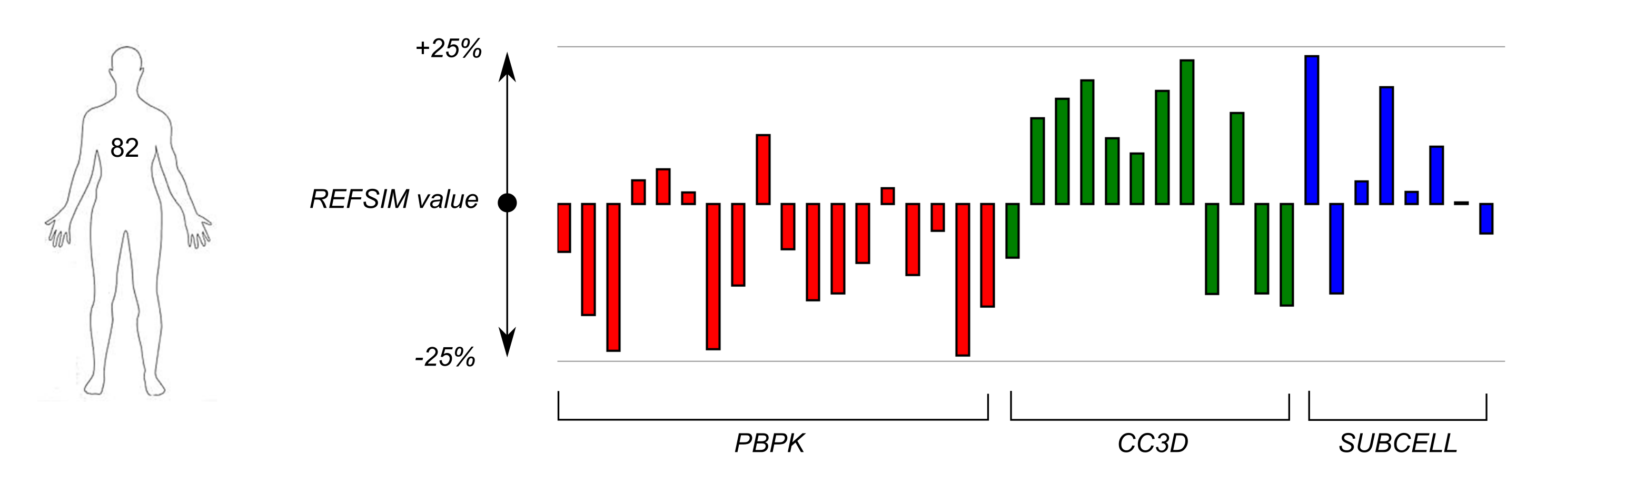
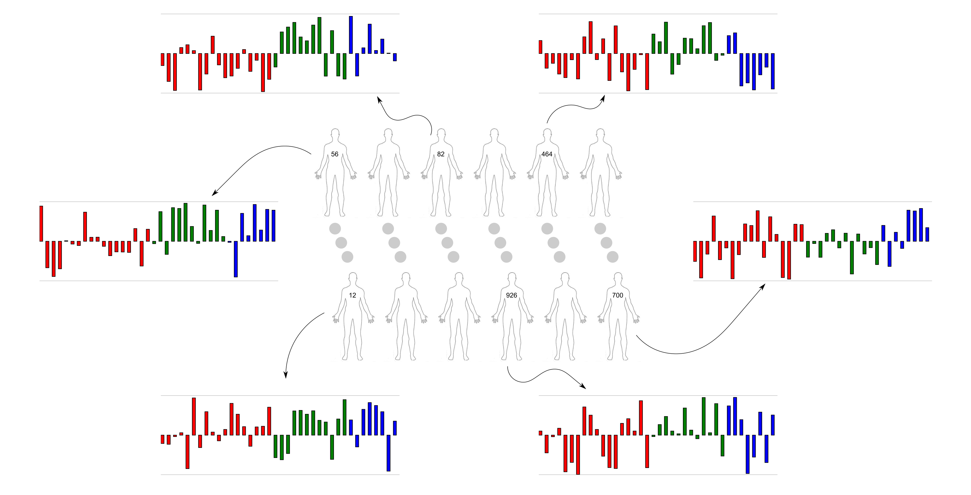
Population Variability in Response
Individual Parameter Profile
Each parameter varies up to 25% with respect to the its value in REFSIM parameter set
Virtual population of 1000 Individuals

Slide 21
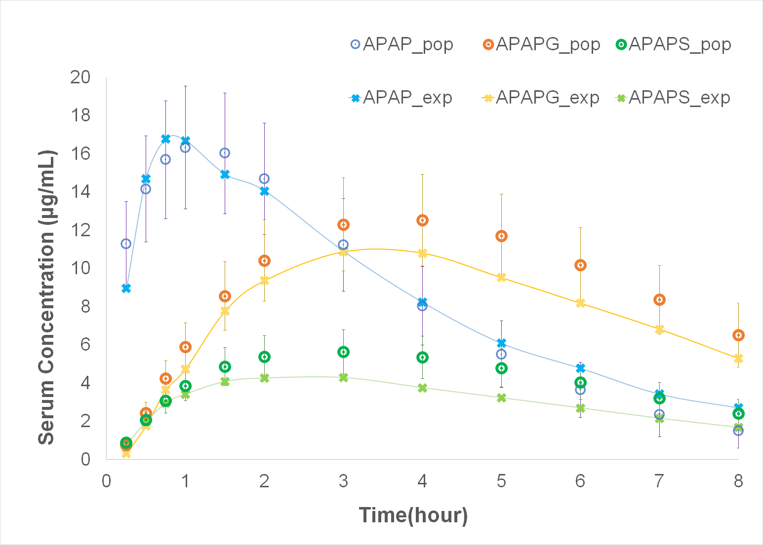
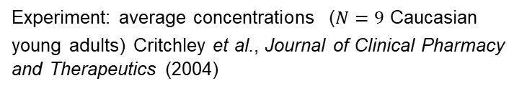
Predicted Serum-level Population Average and Outliers
Average over population agrees with reference simulation
However some individuals have very different serum levels
Experiment: average concentrations ($N=9$ Caucasian young adults) Critchley et al., Journal of Clinical Pharmacy and Therapeutics (2004)
Small individual variations (each parameter is perturbed less than 25% from reference value) in exposure and sensitivity to APAP, and metabolizing capacity can result in large deviations in outputs from population average!

Slide 22
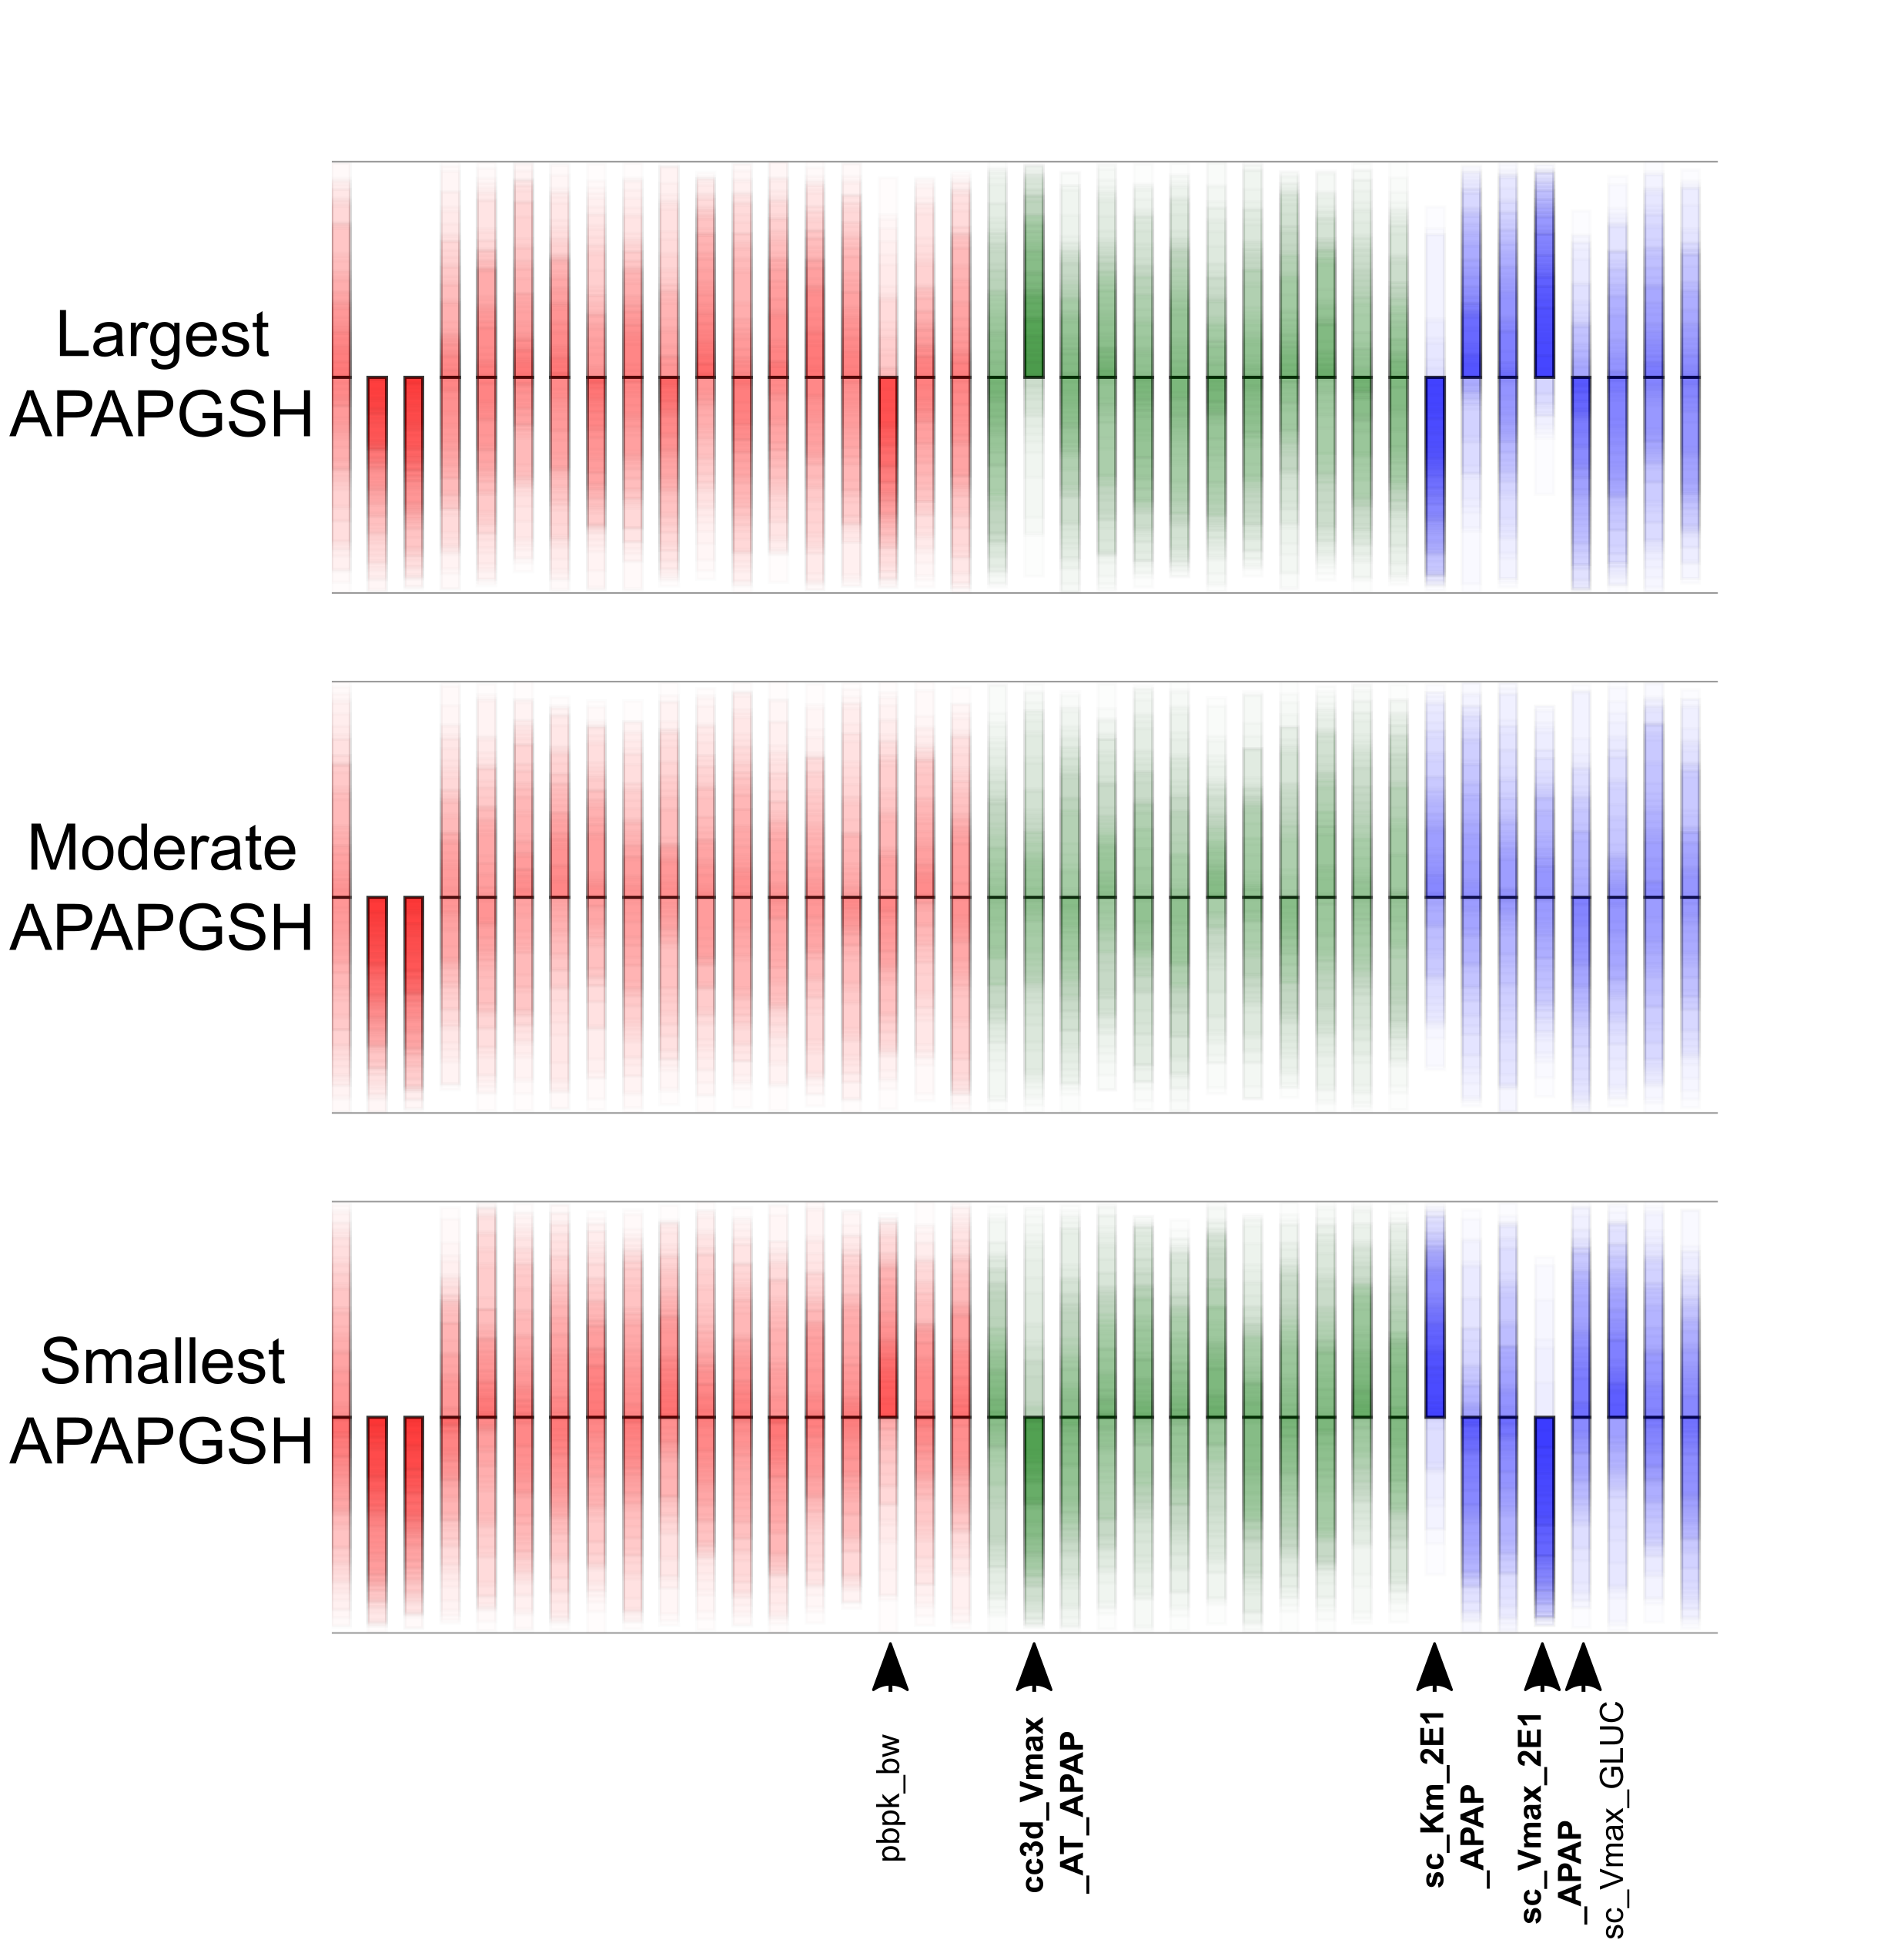
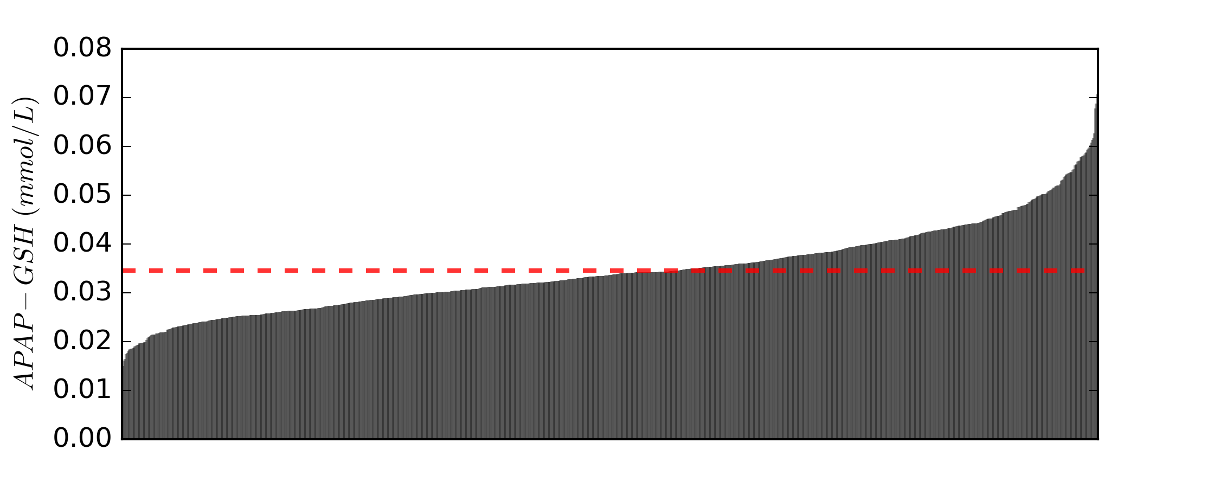
Dominant Factors for Variation in APAP-GSH in Medial and Extremal Populations
APAP-GSH: max cumulative amount of APAP-GSH in any hepatocyte
APAP-GSH
APAP-GSH
APAP-GSH
APAP-GSH

Slide 23
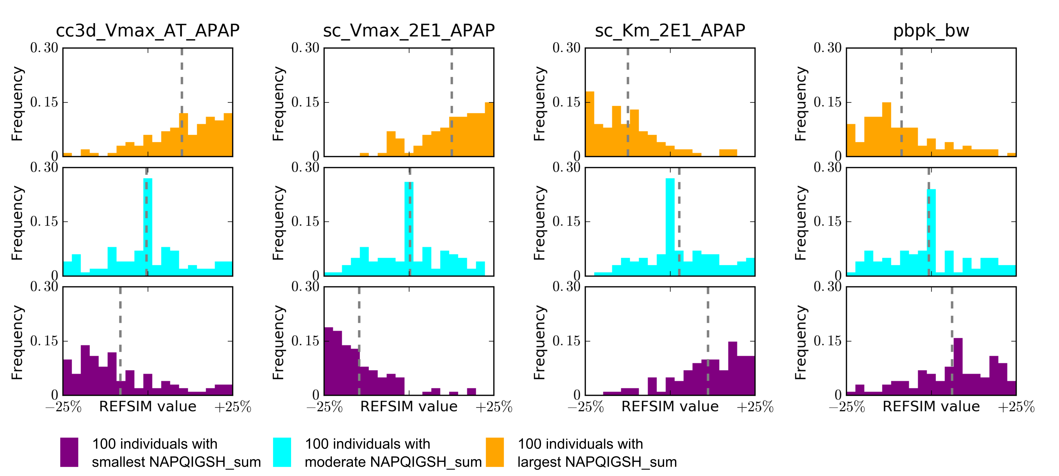
Dominant Factors for Variation in APAP-GSH in Medial and Extremal Populations
APAP-GSH: max cumulative amount of APAP-GSH in any hepatocyte
Max uptake rate of APAP
by hepatocyte
Max metabolic rate
to form NAPQI
Half-saturating concentration
to form NAPQI
Body weight
Most Susceptible
Average Susceptible
Least Susceptible
Serum-level: body weight, hematocrit, protein binding in plasma
Cell-level: CYP450 levels and isoforms, hepatocyte transporter for APAP uptake, body weight

Slide 24
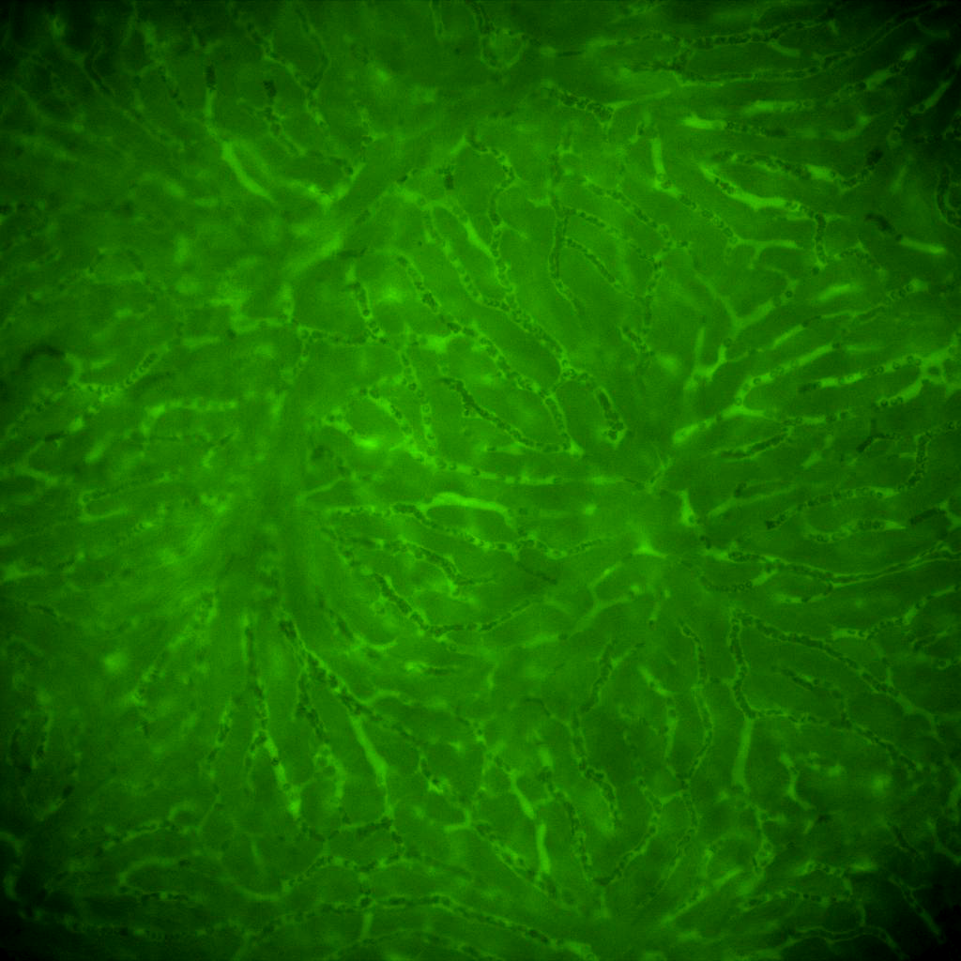
Complications in Microdosimetry—Heterogeneous Flow Velocities in Mouse Liver Sinusoid Networks
Blood flow in mouse liver sinusoid networks following IV injection of 500 kD fluorescent dextran using 3D time-lapse intravital microscopy by Dr. Kenn Dunn

Slide 25
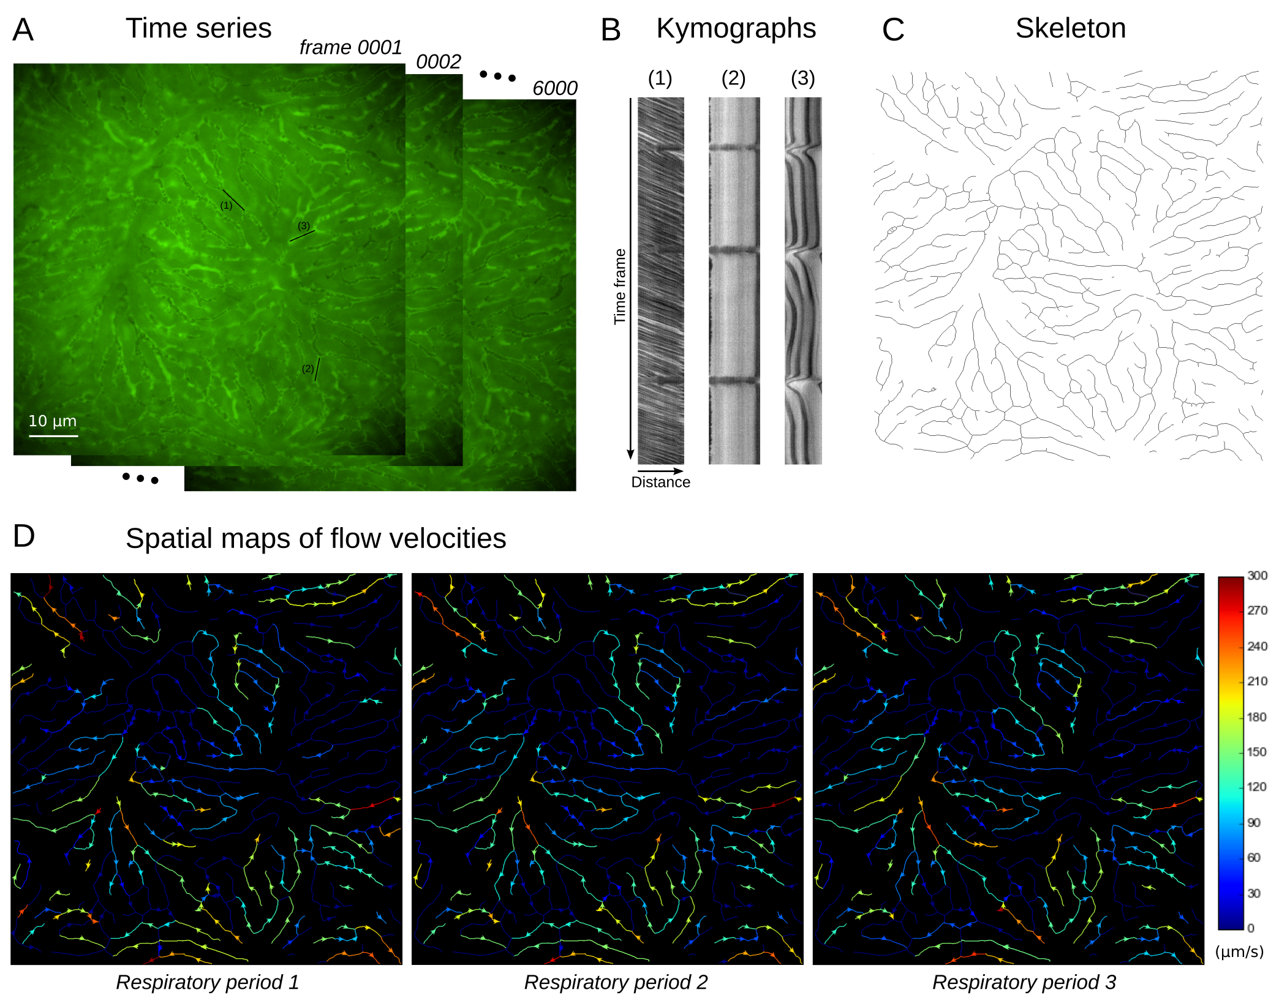
Complications in Microdosimetry—Heterogeneous Flow Velocities in Mouse Liver Sinusoid Networks
Segmentation and Skeletonization by Dr. Clendenon
Kymographs and spatial maps created in Python script
Slope detection from kymographs using Directionality plugin in ImageJ
Blood flow in mouse liver sinusoid networks following IV injection of 500 kD fluorescent dextran using 3D time-lapse intravital microscopy by Dr. Kenn Dunn

Slide 26
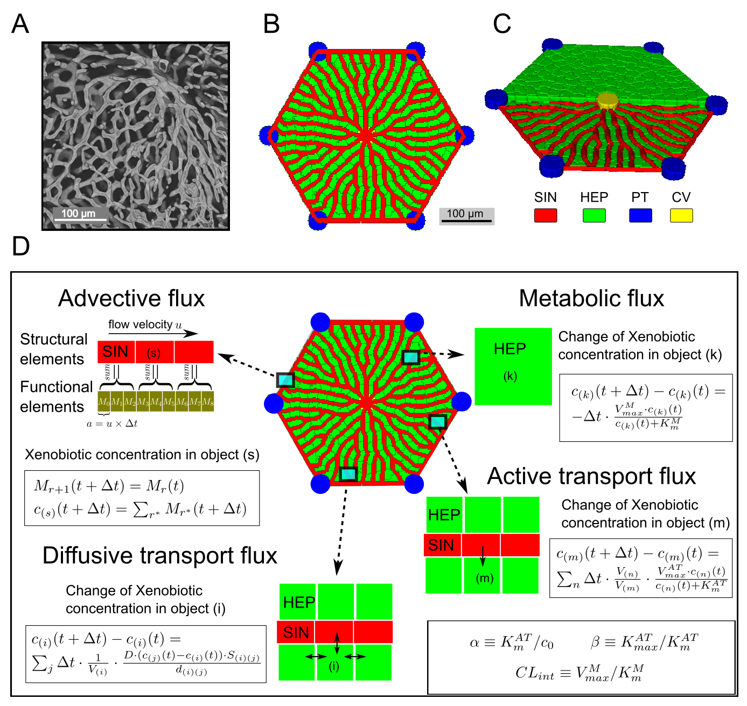
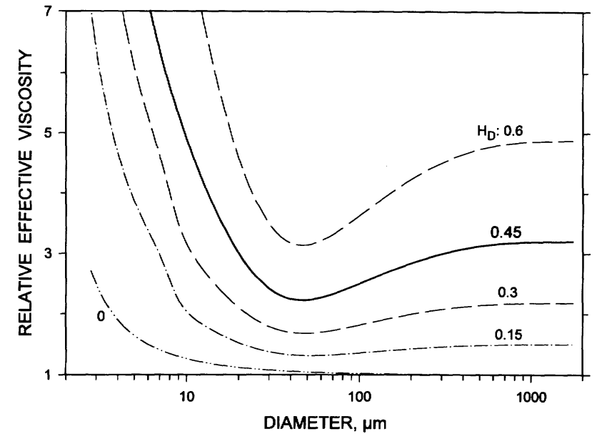
Effect of Flow and Transport on Exposure to Blood-borne compounds
Sinusoid
Hepatocytes
Portal
Triads
Central
Vein
(A) a portion of mouse liver sinusoid network rendered by Dr. Clendenon; (B) (C) virtual liver lobule in CompuCell3D
Hagen-Poiseuille equation applies to calculate blood flow rate in a sinusoid segment:
Fåhræus–Lindqvist effect in vivo
$$Q_{ij}=\frac{π\left(P_{i}−P_{j}\right)D_{ij}^{4}}{128η_{ij}L_{ij}}$$
(Assuming the same sinusoid diameter and hematocrit in the network)
Conservation of flow rate at sinusoid junctions (Kirchhoff’s law)
Pries et al., Circulation research. (1994)

Slide 27
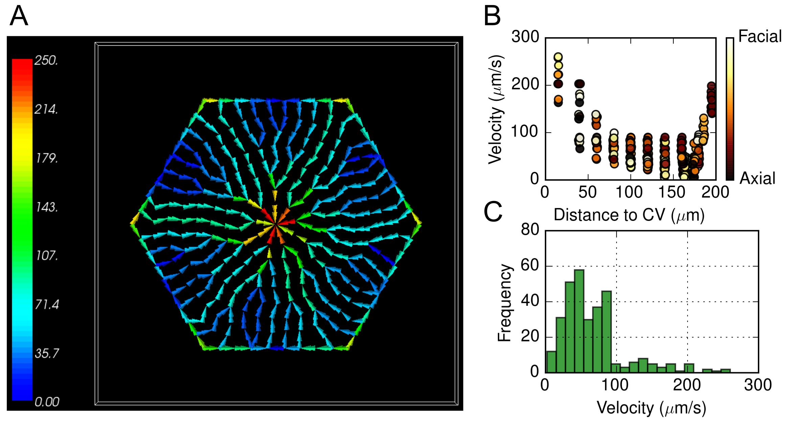
Calculated Flow Velocities

Slide 28
Calculated Xenobiotic Microdosimetry in Virtual Mouse Liver Lobule

Slide 29
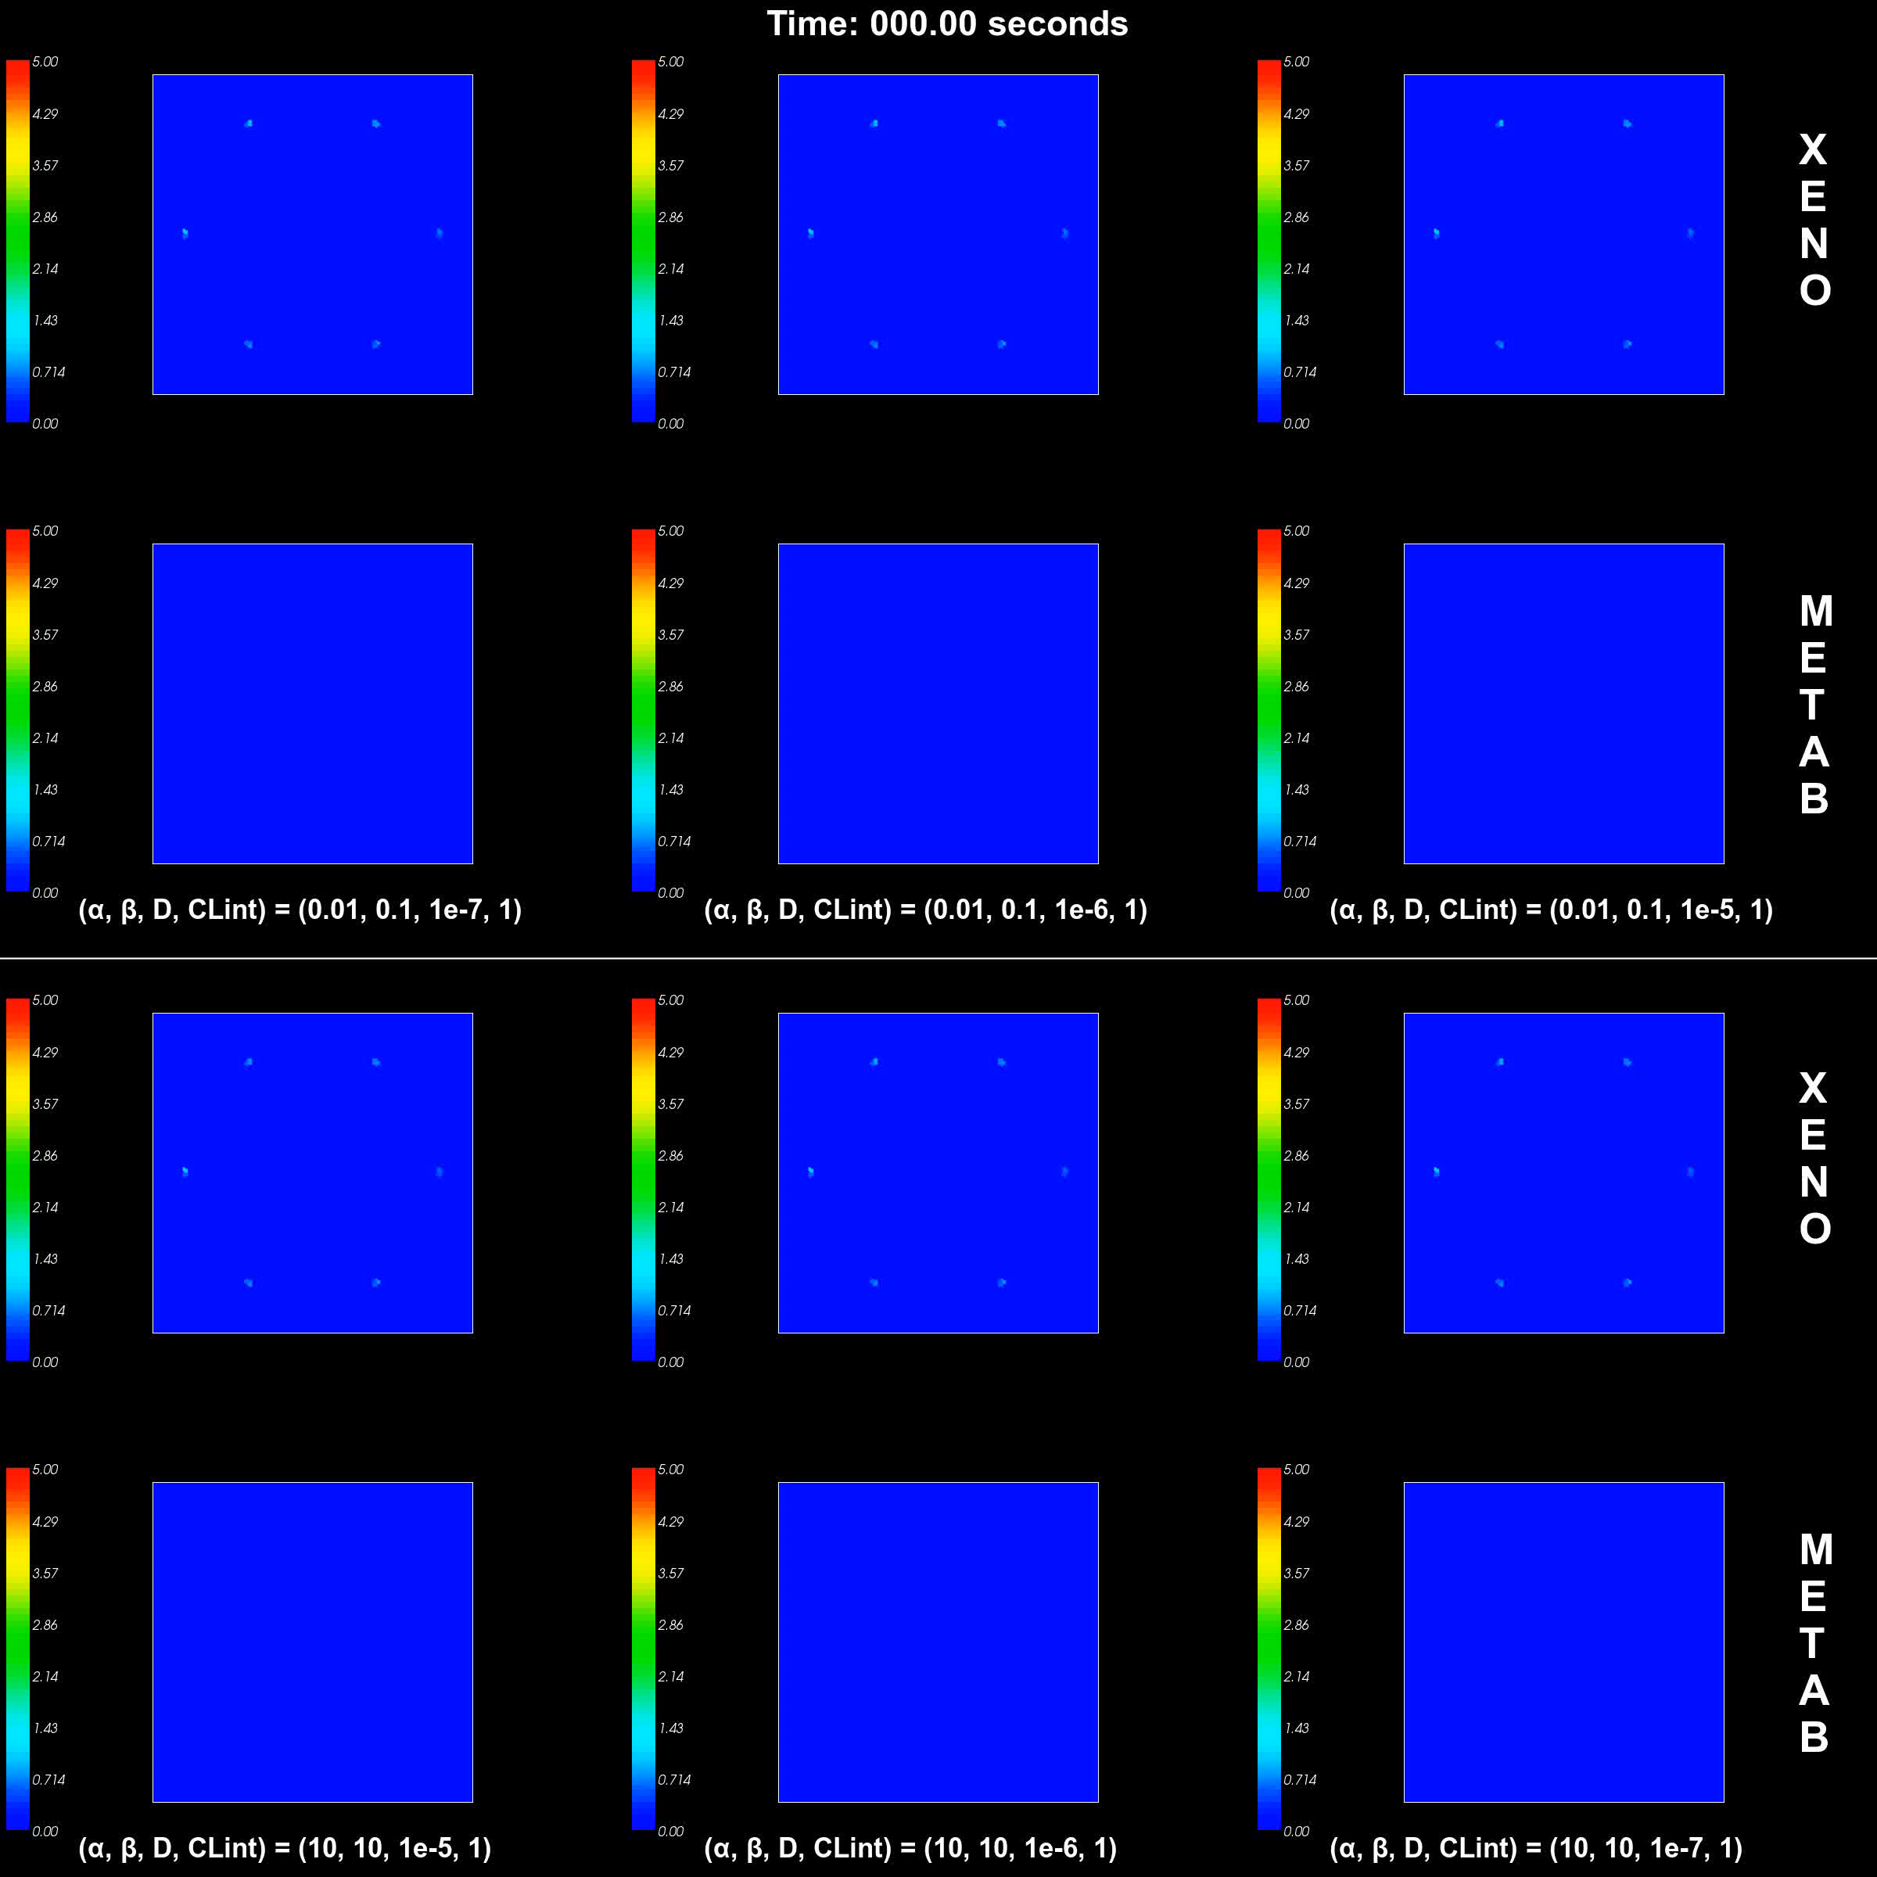
Spatial Variation of Hepatic Exposure to Xenobiotics
Diffusive Transport
Regional variation of cell exposure to xenobiotic depends strongly on cell-level diffusive and active transport in more realistic geometries
Weak
Moderate
Strong
Weak
Active Transport
Strong

Slide 30
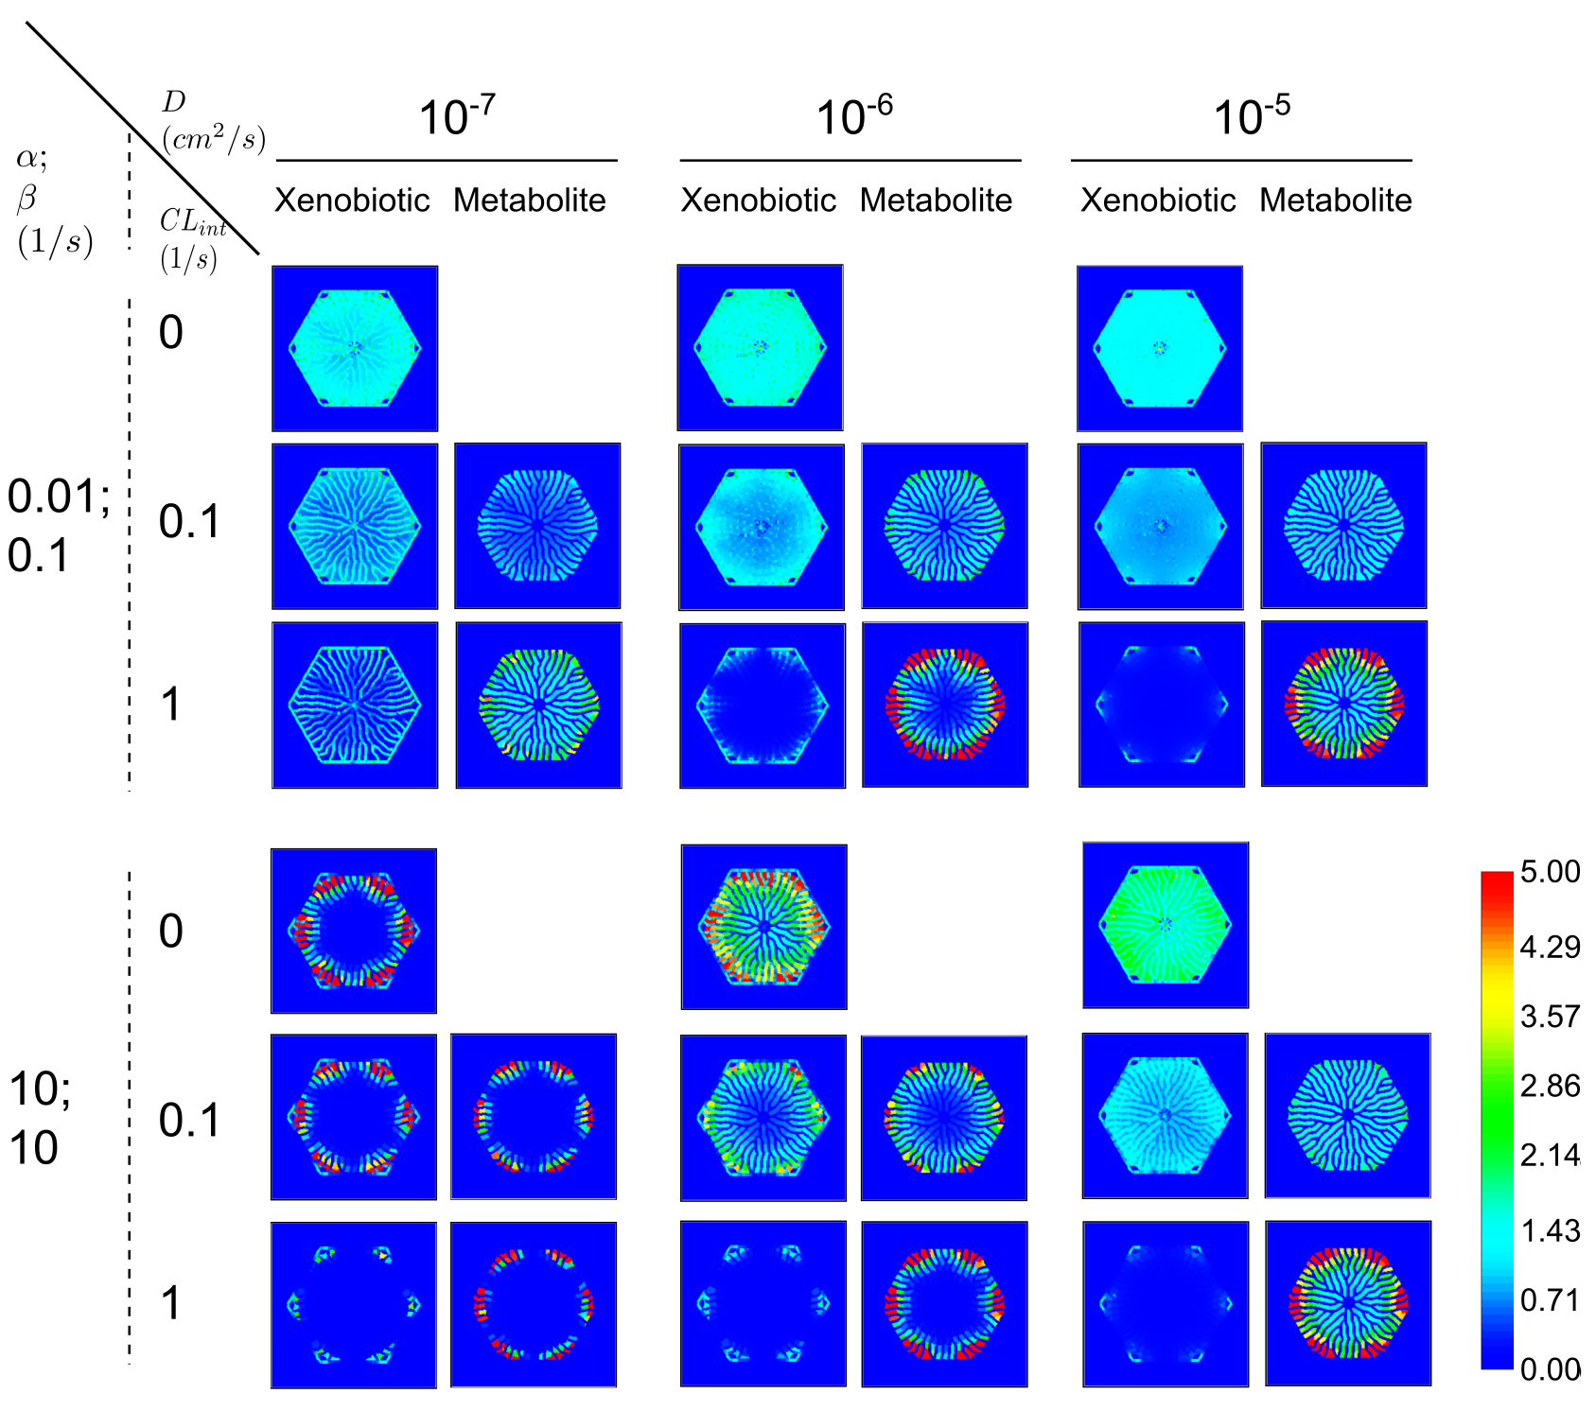
Spatial Variation of Hepatic Exposure to Xenobiotics
Diffusive Transport
Regional variation of cell exposure to xenobiotic depends strongly on cell-level diffusive and active transport in more realistic geometries
Weak
Moderate
Strong
Weak
Active Transport
Strong

Slide 31
Conclusions
Model Relates cell metabolism to clinically measurable serum and urine collected concentrations of APAP and metabolites
Small variations in parameters related to xenobiotic transport and metabolism can result in large variations in cell damage
Detailed uptake properties determine microdosimetry
Next Steps
Calibrate distribution of Phase I metabolism (zonation) and GSH synthesis
Include actual distribution of dominant factors for virtual population
Combine sinusoid model with spatial flow model
Simulate liver injury and recovery following toxic dose of APAP
Sluka, J. P., Fu, X., Swat, M., Belmonte, J. M., Cosmanescu, A., Clendenon, S. G., Wambaugh, J. F., Glazier, J. A. (2016). A Liver-Centric Multiscale Modeling Framework for Xenobiotics. PLoS One 11. (Biological Modeling Best Paper Award for Publication Year 2016 by Society of Toxicology BMSS)
CompuCell3D and SBW Training Workshop, July 29th - August 4th, 2017, Bloomington, Indiana
Still have a few spots open if you are interested—contact me or Andy Somogyi—jaglazier@gmail.com
Sluka, Fu
Notes:
The left image is the central slice of the model and the plane passes through the center of the sinusoids.
The right image is positioned half way between the central sinusoidal plane the sinusoidal plane above it.
Central vein: green circle
Portal triads: blue circles (combined vein, artery and bile duct)
Sinusoid segments: grey and light green
Hepatocytes: cyan
Growing Hepatocytes: grey

Slide 32
Unpredictability of APAP Toxicity
Even therapeutic doses of APAP deplete glutathione significantly in the peri-central region
Thus even small overdoses can be lethal
Taking APAP repeatedly leads to accumulation of NAPQI and reduction in Glutathione reducing the lethal dose
Many drugs and foods change the phase I vs phase II balance
Illnesses, drugs and alcohol can increase phase I and deplete Glutathione reducing the lethal dosage of APAP
Genetic variation, health status, age,… can all affect lethal dose of APAP
Result
Comment—APAP remains available primarily for non-medical political reasons
Sluka

Slide 33
APAP Overdose → Liver Necrosis
Higher CYP expression in
pericentral region.
PT
CV
Peri-central necrosis
in a mouse liver 6 hours after 250mg/kg dose of APAP.
Courtesy of
Dr. Klaunig’s lab
Hinson et al., Handb Exp Pharmacol (2010)

Slide 34
Intra-individual Variation in CYP Activities
Grapefruit ^{[1]}
CYP3A4 inhibition
Alcohol ^{[2]}
Chronic abuse: CYP2E1 induction
Acute intake: CYP2E1 inhibition
[1] Ho et al., J Pharm Pharmaceut Sci (2001)
[2] Schmidt et al., Hepatology (2002)
Hinson et al., Handb Exp Pharmacol (2010)

Slide 35
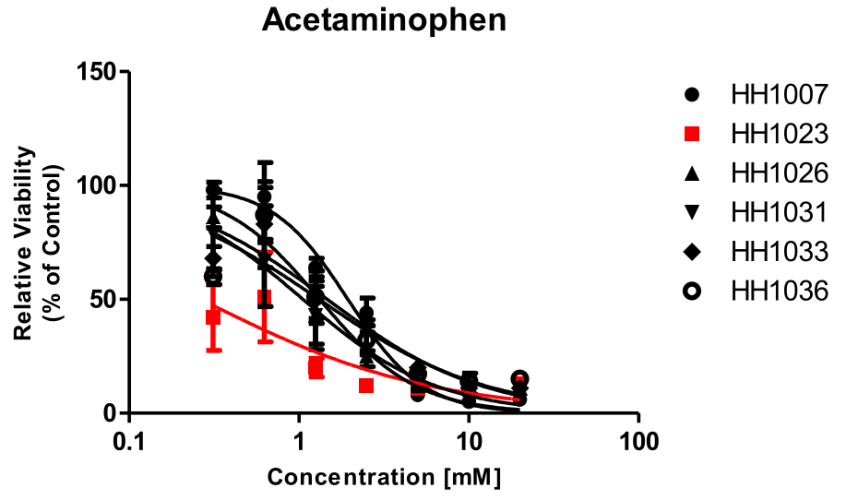
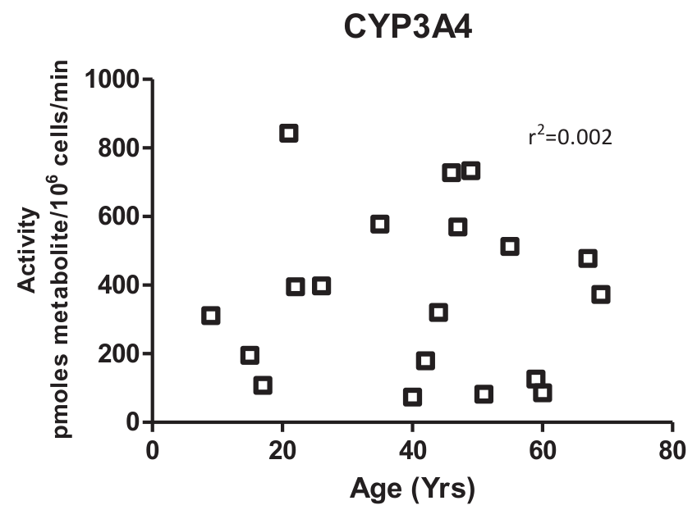
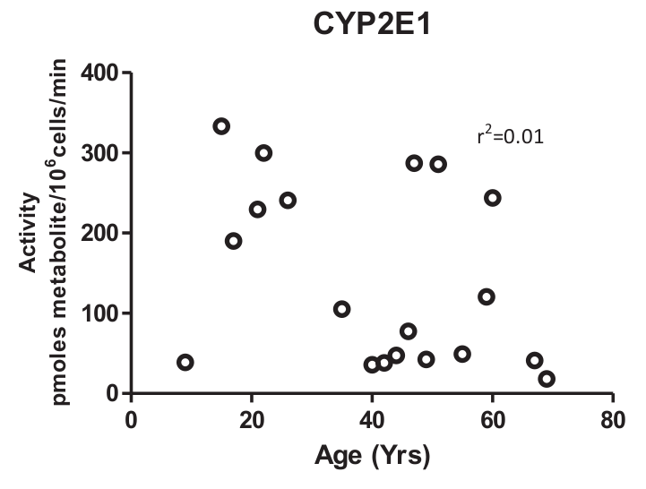
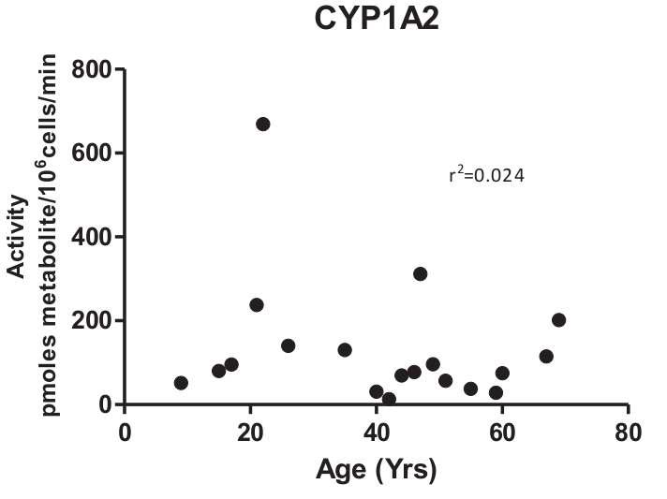
Inter-individual Variation in CYP Activities
Variation of CYP activities
in isolated human hepatocytes from 19 donors
Variation of dose response
in isolated human hepatocytes
Red curve: in donor hepatocytes
with largest CYP3A4 activity
Utakarsh et al., Chemico-Biological Interactions (2016)

Slide 36
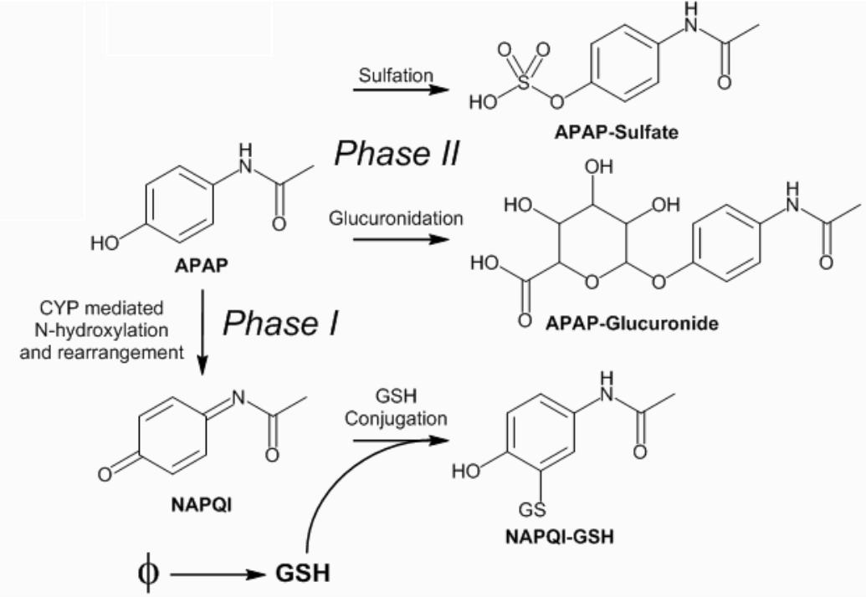

Cell/Subcell RK Submodel
Parameters for sensitivity studies
Michaelis-menten parameters for Phase I and Phase II metabolism (Vmax, Km)
Rate constant for GSH synthesis
Rate constant for NAPQI and GSH conjugation

Slide 37
Validation of the model using human data on serum concentration of acetaminophen and its metabolites Experimental data: Critchley et al. 2005. “Differences in the single-oral-dose pharmacokinetics and urinary excretion of paracetamol and its conjugates between Hong Kong Chinese and Caucasian subjects.”
Snapshots of tissue level concentrations of acetaminophen and its metabolites with time.

Slide 38


Standalone Simulations of PBPK and RK Submodels in COPASI
PBPK and RK submodels specified in Systems Biology Markup Language (SBML) ^{[1]}
loadable in CC3D via Python APIs of LibRoadRunner package ^{[2]}
independently run in COPASI ^{[3]} (an SBML compliant ODE modeling package)
PBPK (70kg human, 20 mg/kg oral dose)
RK (0.1 mmol/L initial APAP concentration)
Serum
Experiment: average concentrations (N=9 Caucasian young adults)
Critchley et al., Journal of Clinical Pharmacy and Therapeutics (2004)
[1] Hucka et al., Bioinformatics (2003)
[2] Somogyi et al., Bioinformatics (2015)
[3] Hoops et al., Bioinformatics (2006)

Slide 39


Liver Flow/Transport Submodel
Hepatocytes
Red blood cells
Serum portions
Transport of APAP, APAPG and APAPS
flow
Peri-portal
Peri-central
Glazier-Graner-Hogeweg model ^{[1]} of blood flow in CC3D ^{[2]}
HEP – Hepatocyte; RBC – Red blood cell; SP – Serum portion
Parameters for sensitivity studies
Rate constants for passive transfer of APAP (k_PD)
Michaelis-menten parameters for active transport of APAP (Vmax_AT, Km_AT)
Rate constants for active export of APAPG and APAPS
Hematocrit (volume fraction of RBCs in simulated blood)
[1] Glazier et al., Phys. Rev. E (1993)
[2] Swat, et al., Methods in Cell Biology (2012)

Slide 40

Liver Flow/Transport Submodel
Hepatocytes
Red blood cells
Serum portions
Transport of APAP, APAPG and APAPS
flow
Peri-portal
Peri-central
Glazier-Graner-Hogeweg model ^{[1]} of blood flow in CC3D ^{[2]}
HEP – Hepatocyte; RBC – Red blood cell; SP – Serum portion
Parameters for sensitivity studies
Rate constants for passive transfer of APAP (k_PD)
Michaelis-menten parameters for active transport of APAP (Vmax_AT, Km_AT)
Rate constants for active export of APAPG and APAPS
Hematocrit (volume fraction of RBCs in simulated blood)
[1] Glazier et al., Phys. Rev. E. (1993)
[2] Swat, et al., Methods in Cell Biology. (2012)

Slide 41
Standalone Simulation of Multicell Flow/Transport Submodels in CC3D
Constant inflow APAP concentration between 1st and 3rd simulated seconds.

Slide 42
Complete Simulation Integrating Submodels
Serum concentrations of
APAP, APAPG and APAPS
REFSIM simulation
70 kg human
20 mg/kg oral dose
PBPK compartmental
concentrations of APAP
(left)
Spatio-temporal progression of APAP, APAPG and APAPS concentrations in the virtual liver lobule
Subcellular concentrations
of GSH in select hepatocytes
Time (hour)

Slide 43

Complete Simulation Integrating Submodels
APAP
GSH
REFSIM simulation
Concentration
Concentration
70 kg human
20 mg/kg oral dose
Time (hour)
Time (hour)
NAPQI
APAP-GSH
Time series of average zonal chemical concentrations in the virtual liver lobule
Concentration
Concentration
Time (hour)
Time (hour)
APAPG
APAPS
PP – Peri-portal
MZ – Mid-zonal
PV – Peri-venous (Peri-central)
(markers
in figures)
Concentration
Concentration
Time (hour)
Time (hour)

Slide 44
Parameter Sensitivity Pattern 1 – large parameter influence on most descriptors
Serum-level
descriptor
pbpk_hemat
cc3d_Vmax_AT_APAP
Hematocrit (volume fraction of red blood cells
in the blood)
Michaeli-Menten parameter: maximum uptake rate of APAP by a hepatocyte via active transport

Slide 45
Parameter Sensitivity Pattern 2 – small parameter influence on all descriptors
Serum-level
descriptor
pbpk_Kk2p
Kidney:Plasma partition
coefficient of a chemical
(equilibrium ratio of chemical concentration in tissue to that in blood plasma)
cc3d_k_AT_APAPG
First-order rate constant of active export of APAPG or APAPS by a hepatocyte
cc3d_k_AT_APAPS

Slide 46
Parameter Sensitivity Pattern 2 – small parameter influence on all descriptors
Serum-level
descriptor
cc3d_k_PD
sc_Km_2E1_APAP
Passive transfer rate constants of APAP between generalized cells
sc_Vmax_2E1_APAP
sc_kGsh
sc_kNapqiGsh
Michaelis-menten constants of CYP-mediated Phase I metabolism of APAP
Rate constant of GSH synthesis
Rate constant of GSH conjugation with NAPQI

Slide 47
Parameter Sensitivity Pattern 4 – compound-specific and cross-compound parameter influence
Serum-level
descriptor
AUC
Area under the curve of serum-level time series of chemical concentrations
sc_Km_GLUC
sc_Km_SULF
sc_Vmax_GLUC
sc_Vmax_SULF
Michaelis-menten constants of CYP-mediated Phase II metabolism of APAP to form APAPG
Michaelis-menten constants of CYP-mediated Phase II metabolism of APAP to form APAPS

Slide 48





Inter-individual Variation in Serum-level and Cell-level Descriptors
sort
AUCA
AUCA
Individual ID
Ranked Individual ID
sort
CmaxA
CmaxA
Individual ID
Ranked Individual ID
sort
APAP-GSH
APAP-GSH
Individual ID
Ranked Individual ID

Slide 49

Aggregate Parameter Signature of a Subpopulation
$$\frac{1}{N}\sum{}$$
(Average of N
parameter signatures)
AUCA

Slide 50
Dominant Factors for Variation in AUCA in Medial and Extremal Populations
AUCA: Area under the curve for serum concentration profile of APAP
AUCA

Slide 51

Dominant Factors for Variation in AUCA in Medial and Extremal Populations
AUCA: Area under the curve for serum concentration profile of APAP
Body weight
Hematocrit
Unbound fraction of APAP
in blood serum
Max metabolic rate
to form NAPQI

Slide 52

Dominant Factors for Variation in CmaxA in Medial and Extremal Populations
CmaxA: Peak serum concentration of APAP
CmaxA

Slide 53

Dominant Factors for Variation in CmaxA in Medial and Extremal Populations
CmaxA: Peak serum concentration of APAP
Body weight
Hematocrit
Unbound fraction of APAP
in blood serum
Max metabolic rate
to form NAPQI

